Slide 1




One Community Program (OCP)
Sponsored by:
Somali Women’s Health Workshop Series
Notes:
Describe the One Community Program (Slide 1).

Slide 2
Introduction to the One Community Program (OCP)
Module 1
Session 1
Notes:
Introduce the module (Slide 2).

Slide 3
Agenda
Review of Learning Objectives
Opening
Introduction to the One Community Project
Workshop Expectations
Somali Cultural Traditions
American Cultural Traditions
Cultural Comparisons
Closing
Notes:
Show Slide 3 and go over the agenda with the participants.
Review of Learning Objectives
Opening
Introduction to the One Community Project
Workshop Expectations
Somali Cultural Traditions
American Cultural Traditions
Cultural Comparisons
Closing and Workshop Feedback

Slide 4
Learning Objectives
Introduce the One Community Project
Review format and expectations of the workshop
Compare and contrast cultural traditions of Somalia and America with a specific focus on health-related differences
Create a safe space for learning and discussion
Notes:
Review the learning objectives, shown on Slide 4, with the participants.
• Introduce the One Community Project
• Review format and expectations of the workshop
• Compare and contrast cultural traditions of Somalia and America with a specific focus on health-related differences
• Create a safe space for learning and discussion

Slide 5
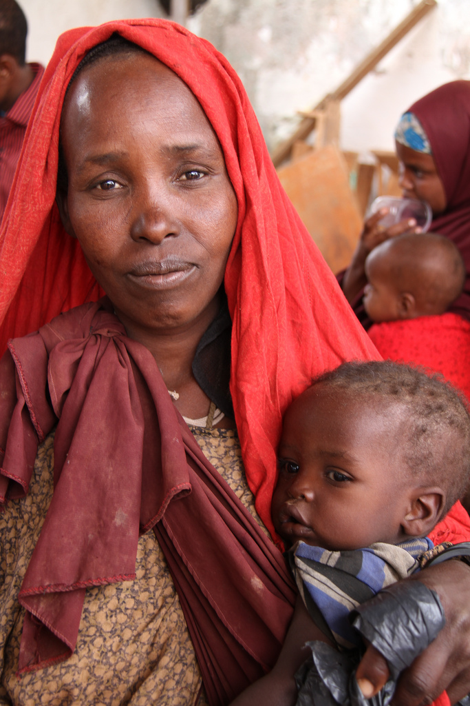
Introduce yourself
When did you come to America?
Tell us about your family
Notes:
Slide 5 is an opening icebreaker activity. The goal of this icebreaker activity is to warm up the conversation among the participants. The activity should provide an opportunity for participants to learn something about each other and the facilitator. The facilitator should be prepared to also have an answer to these questions. If possible, having answers related to preventative health would be preferable.
The facilitator should ask participants to introduce themselves and then ask the questions, When did you come to America? Tell us about your family
Pause to allow participants to consider their answers.
Ask participants if they would like to share the information. Allow those that volunteer to share the opportunity to do so.
Ask any remaining participants if they would like to share their stories, making sure to ask everyone.
Once everyone has shared, reflect back to the group any themes that came out.

Slide 6

“Aqoon la’aani waa iftiin la’aan.”
“The absence of knowledge is the absence of light.”
-Somali Proverb
Notes:
Show Slide 6, which shows a Somali proverb
“Aqoon la’aani waa iftiin la’aan”
“The absence of knowledge is the absence of light “
Tell the participants that over the next eight sessions the goal of the workshop is to increase their knowledge.

Slide 7
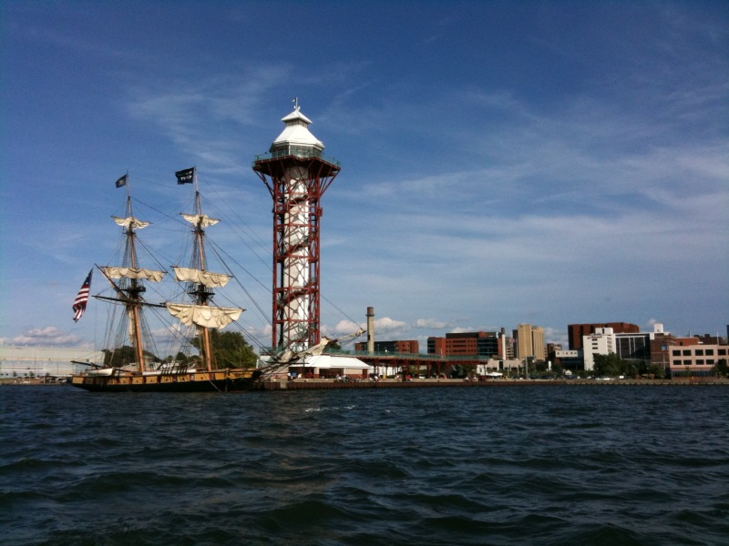
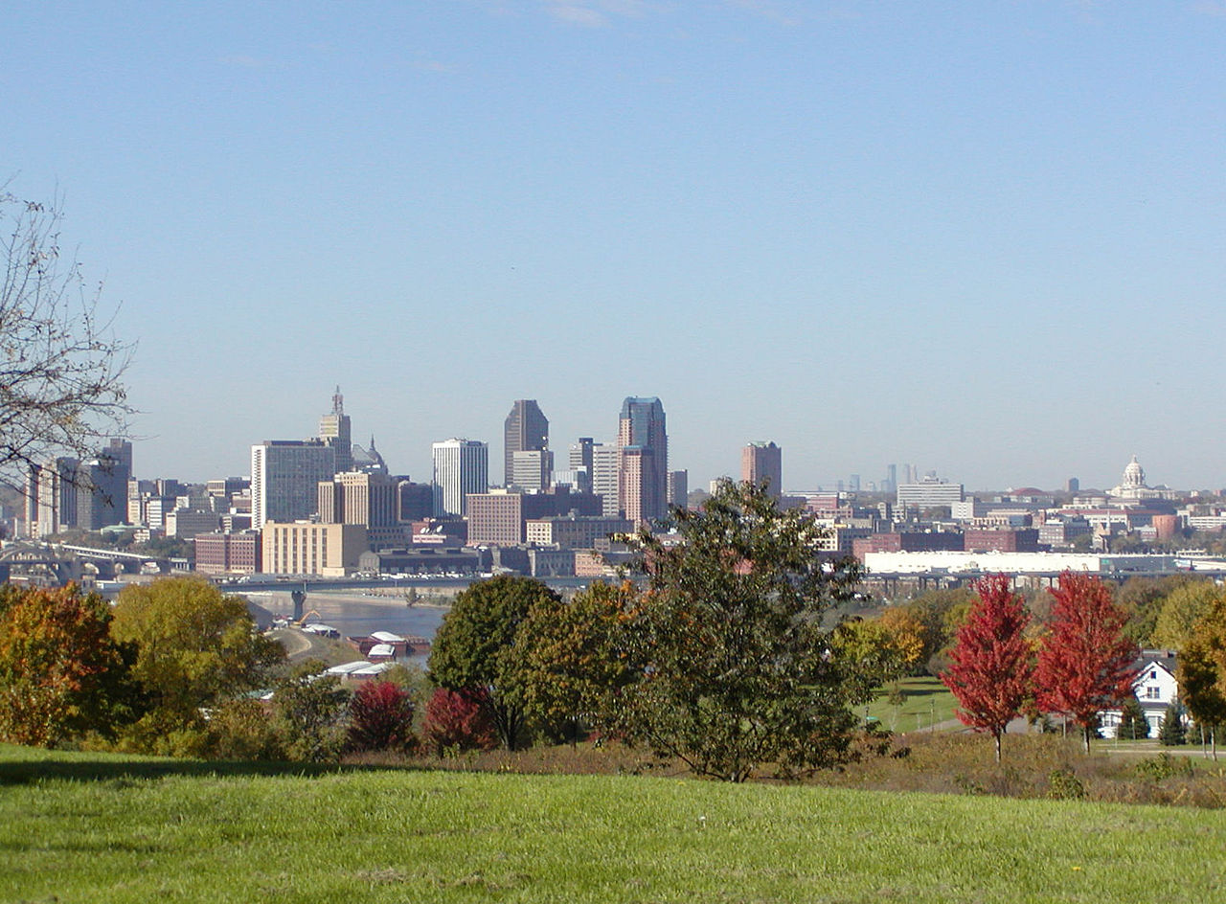
One Community Program
U.S. Committee for Refugees and Immigrants (USCRI)
Erie, PA
Minneapolis/St. Paul, MN
Female Genital Cutting (FGC)
Somali community
Other refugee and immigrant groups
Notes:
Show Slide 7. Describe the program:
The One Community Program is a workshop developed collaboratively by the U.S. Committee for Refugees and Immigrants (USCRI), the International Institute of Erie (IIE), and the International Institute of Minnesota. It is funded by the U.S. Office of Women’s Health. The goals of the program are to provide education to the Somali community and other refugee and immigrant groups about health-related cultural issues, especially regarding Female Genital Cutting (FGC).

Slide 8
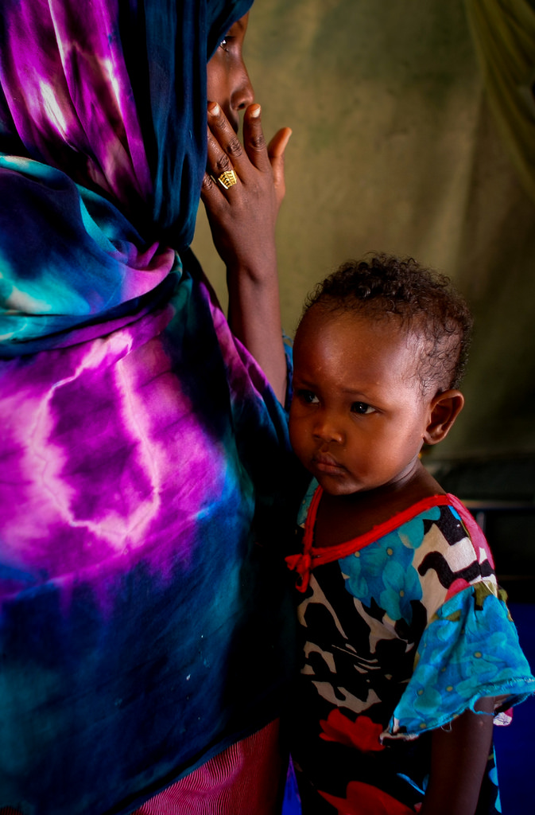
OCP Objectives
Increase awareness and knowledge among women with FGC
Improve self-care
Assist with informed decision-making for new generations of Somali girls at risk of FGC
Notes:
Show Slide 8. Introduce the participants to the objectives of the One Community Program
Increase awareness and knowledge among women with FGC
To improve self-care
To assist with informed-decision making for new generations of Somali girls at the risk of FGC.

Slide 9
Workshop Expectations
Facilitator
Will attend all sessions
Facilitate an active learning environment
Provide accurate information to participants
Participate in discussions and activities
Be patient and listen to participants
Show respect and empathy to all participants
Be open to feedback from participants
Notes:
Distribute handout 1.1.1: WORKSHOP EXPECTATIONS
Show Slide 9. List the workshop expectations for yourself, the facilitator:
Will attend all sessions
Facilitate an active learning environment
Provide accurate information to participants
Participate in discussions and activities
Be patient and listen to participants
Show respect and empathy to all participants
Be open to feedback from participants
Ask the participants if they have any other expectations of you. Write those down on a white board or newsprint.

Slide 10
Workshop Expectations
Participants
1-1.5 hours/week for 8 sessions
Attend all sessions
Make up all missed sessions
Notify instructor of absences
Participate in discussions and activities
Keep an open mind
Certificate of completion
Notes:
Show Slide 10. List the workshop expectations for the participants:
Will attend 1-1.5 hours per week for 8 sessions
Attend all sessions
Make up any missed sessions
Notify the instructor of absences
Participate in discussions and activities
Keep an open mind
Certificate of completion
Ask the participants if they have any expectations of each other. These may include confidentiality or honesty. Write those down on a white board or newsprint.

Slide 11

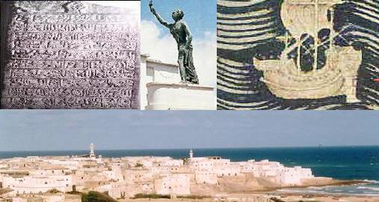
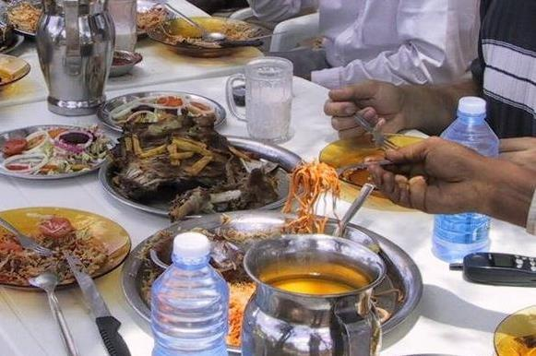
What are some Somali cultural traditions that you practice?
Notes:
Distribute handout 1.1.2: SOMALI AND AMERICAN CULTURAL TRADITIONS
Introduce the Think-Pair-Share. Instruct the participants that they will be shown some questions and that they are to take one minute alone (being quiet) to think of the questions on the slide and their answers to those questions. After a minute, the participants will pair up and share their answers. After sharing with a partner, they will share their answers with the group. The participants can use the handout to write their answers or take notes if they wish.
Show Slide 11 regarding Somali cultural traditions. Remind participants of the Think-Pair-Share directions. Write all responses on the white board or newsprint.
What are some Somali cultural traditions that you practice?

Slide 12

Your Cultural Traditions
Food
Names and naming
Marriage and weddings
Post-partum practices
Male and female circumcision
Notes:
Show Slide 12. Show each topic and write answers on the white board or newsprint. Ask, “Why do you practice this? What happens if you don’t practice this? How is this done?”
Food
Names and naming
Marriage and weddings
Post-partum practices
Male and female circumcision

Slide 13

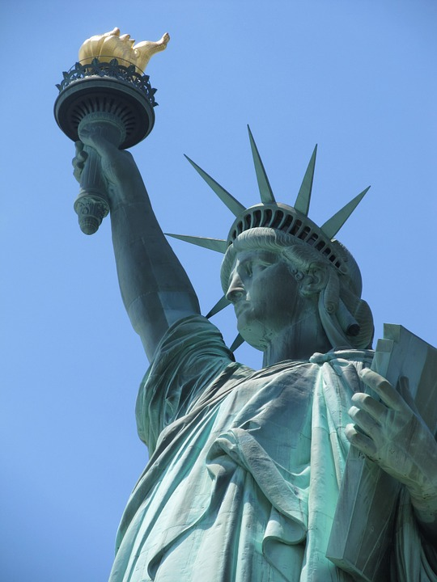
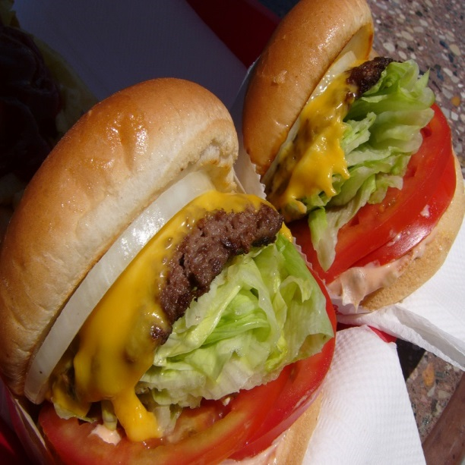
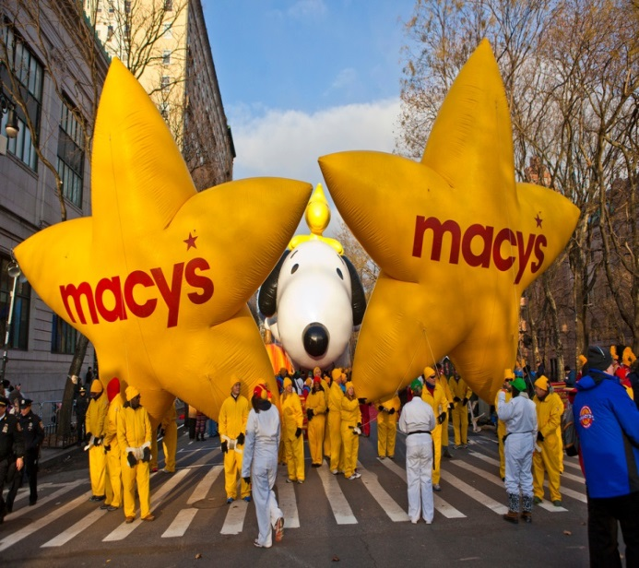
What are some American cultural traditions that are confusing or surprising to you?
Notes:
Show Slide 13 regarding American cultural traditions. Remind participants of the Think-Pair-Share directions. Write all responses on the white board or newsprint.
What are some Somali cultural traditions that you practice?

Slide 14

American Cultural Traditions
Notes:
Distribute handout 1.1.3: 25 THINGS VISITORS FIND SURPRISING ABOUT THE UNITED STATES
Show Slide 14. Press play to show the video (25 Things That Visitors Will Find Most Surprising about America; 7:20). Then facilitate a discussion. Ask the participants what themes they noticed and write these down on the white board or newsprint. Some potential themes from the video include
Minimal regulation from the federal government
States are run independently
Capitalism and the “Wild West” mentality
Individualism and everything is earned.
Video: https://www.youtube.com/watch?v=vT_-viaUegI

Slide 15
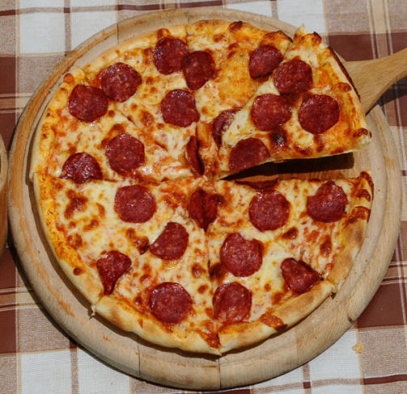


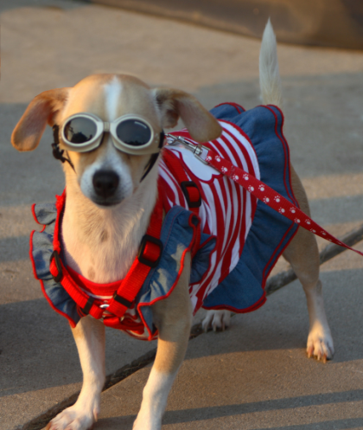
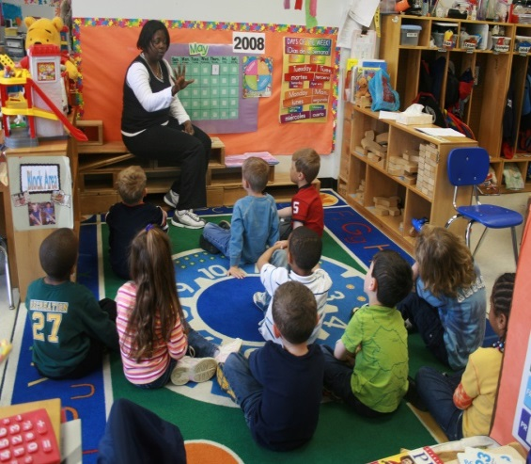

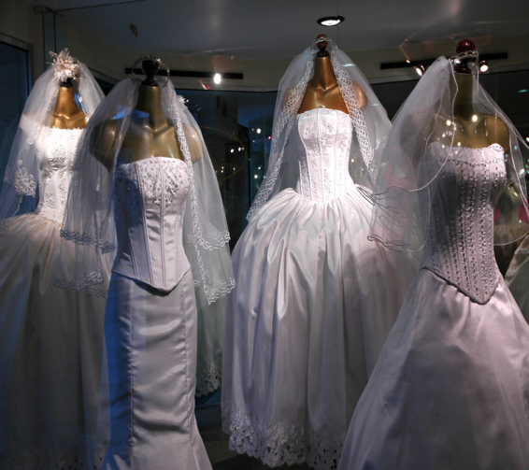
American Cultural Traditions
Notes:
Show Slide 15. Continue to facilitate a discussion about specific cultural traditions of America and how they are similar or different from cultural traditions of Somalia. Write responses on the white board or newsprint. For this slide, topics of conversation can include
Food
Holidays
Pets/Wearing the flag
Education
Names and naming
Marriage and weddings

Slide 16
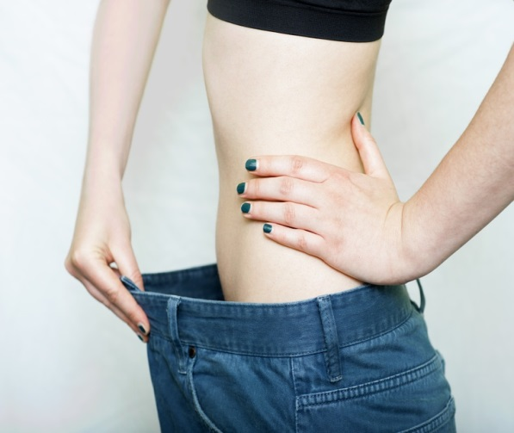


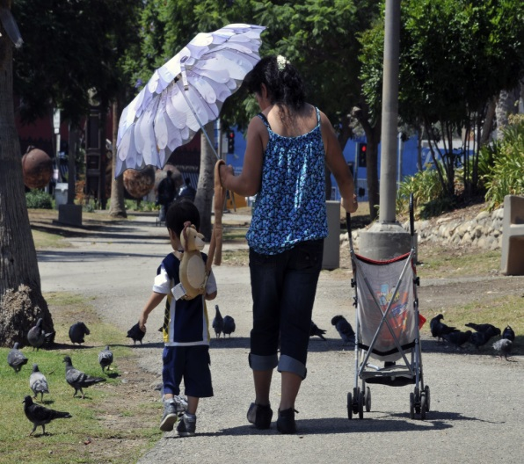


American Cultural Traditions
Notes:
Show Slide 16. Continue to facilitate a discussion comparing and contrasting American and Somali cultural traditions. Write responses on the white board or newsprint. For this slide, topics of conversation can include
Braces
Dieting
Medicine
Ear piercing for babies
Child care practices
Technology

Slide 17

Cultural Adaptation
Notes:
Show Slide 17. Press play to show the video (Cultural Differences; 4:58). Then facilitate a discussion. Write down responses on the white board or newsprint. Ask some of the following questions:
Was your experience of adapting to American cultural similar or different than the people in the film?
Were there any other things you thought were strange when you first came here?
Video available at: https://www.youtube.com/watch?v=BT0kzF4A-WQ&t=2s

Slide 18
Cultural Comparisons
What are some things that have been challenging to adapt to here in America?
What has helped you to adapt?
What are some cultural similarities between Somali and American culture?
Notes:
Show Slide 18. Facilitate a discussion about cultural adaptation to America. Ask participants to provide answers to the following questions. Write responses on the white board or newsprint.
What are some things that have been challenging to adapt to here in America?
What has helped you to adapt?
What are some cultural similarities between Somali and American culture?

Slide 19

“Modern Civilized Society”
Notes:
Show Slide 19. Acknowledge that Western Society has its share of odd expectations. Tell the participants that to begin to close they will watch a short clip that exposes some of the odd expectations of Western society. Press play to show the video (The Gods Must Be Crazy – Modern Civilized Society, 2:33). Then facilitate a discussion using the following questions:
Do you see any truth to the video?
What was funny about the video?
Video Available at : https://www.youtube.com/watch?v=zz04A_cgZMQ&t=4s

Slide 20

Closing
What is one ‘take away’ from today’s session?
What questions do you have?
Notes:
Show Slide X. Thank everyone for coming and participating, as well as thank all the participants for coming. Ask the following questions and allow a few minutes for answers.
What is one ‘take away’ from today’s session?
What questions do you have?
Distribute the WORKSHOP EVALUATION FORM. Ask participants to complete and return it to the facilitator.
The facilitator should complete the FIDELITY CHECKLIST AND FACILITATOR FEEDBACK FORM after the completion of the module.

