Slide 1




One Community Program (OCP)
Sponsored by:
Somali Women’s Health Workshop Series
Notes:
Remind the participants about what the One Community Program is (Slide 1)

Slide 2
Preventive Healthcare
Module 2 Session 2
Notes:
Introduce the module (Slide 2).

Slide 3
Agenda
Review of Learning Objectives
Opening
Introduce Preventive Healthcare
Annual Physical Exams
Common Health Conditions and Preventive Tests
Faduma’s Story
Closing
Notes:
Show Slide 3 and go over the agenda with the participants.
Review of Learning Objectives
Opening
Introduce Preventive Healthcare
Annual Physical Exams
Common Health Conditions and Preventive Tests
Faduma’s Story
Closing and Workshop Feedback

Slide 4
Learning Objectives
Describe preventive healthcare
Summarize what happens at an annual physical exam
Review common health conditions and preventive tests
Explain the importance of taking prescribed medications
Notes:
Review the learning objectives, shown on Slide 4, with the participants.
Describe preventive healthcare
Summarize what happens at an annual exam
Review common health conditions and preventive tests
Explain the importance of taking prescribed medications

Slide 5


What is one GOOD thing that happened today?
What is one BAD thing that happened today?
Notes:
Slide 5 is an opening icebreaker activity. The goal of this icebreaker activity is to warm up the conversation among the participants. The activity should provide an opportunity for participants to learn something about each other and the facilitator. The facilitator should be prepared to also have an answer to these questions. If possible, having answers related to preventative health would be preferable.
The facilitator should ask the questions: What is one GOOD thing that happened today? What is one BAD thing that happened today?
Pause to allow participants to consider their answers.
Ask participants if they would like to share the information. Allow those that volunteer to share the opportunity to do so. Ask any remaining participants if they would like to share their stories, making sure to ask everyone.
Reflect back to the group any themes that came out.

Slide 6
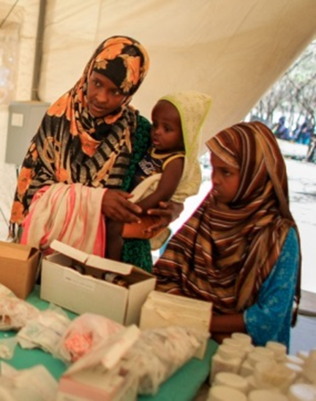
What diseases do you know of or have had to deal with?
What was the treatment and what was the outcome?
Notes:
Distribute handout 2.2.1: HEALTHCARE HISTORY AND PREVENTIVE CARE
Introduce the Think-Pair-Share. Instruct the participants that they will be shown some questions and that they are to take one minute alone (being quiet) to think of the questions on the slide and their answers to those questions. After a minute, the participants will pair up and share their answers. After sharing with a partner, they will share their answers with the group. The participants can use the handout to write their answers or take notes if they wish.
Show Slide 6 regarding diseases participants have had and the outcomes. Remind participants of the Think-Pair-Share directions. Show each question in turn.
What diseases do you know of or have had to deal with?
What was the treatment and what was the outcome?

Slide 7
Preventive Healthcare
Average age of death
Somalia
America
50 years old
80-90 years old
Why do you think people live longer in America?
Notes:
Show Slide 7 regarding the average age of death. Show the average age of death for people who are living in Somalia (around 50). Then show that the average age of death for people living in America is between 89 and 90 years old. Ask participants
Why do you think people live longer in America?
When participants are answering this question, probe and ask about lifestyle differences (proximity to health care facilities and pharmacies, access to healthcare, etc.)

Slide 8
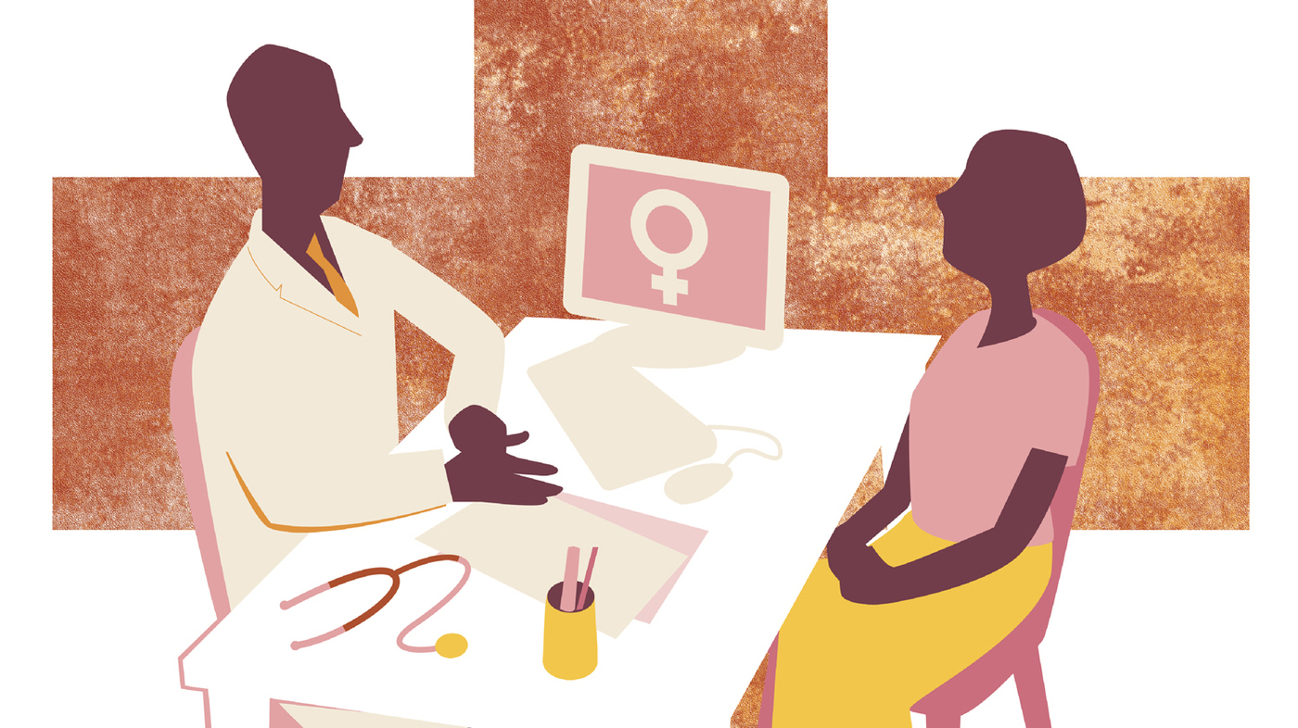
Preventive Healthcare
Do you go for your annual physical exam?
Why do you go?
What are the reasons you don’t go for these exams?
Notes:
Show Slide 8. Remind the participants of the directions for the Think-Pair-Share activity. Show each question in turn.
Do you go for your annual physical exam?
Why do you go?
What are the reasons you don’t go for these exams?
Follow up the Think-Pair-Share activity by discussing the importance of annual exams in determining one’s health and early detection of any illnesses or diseases

Slide 9
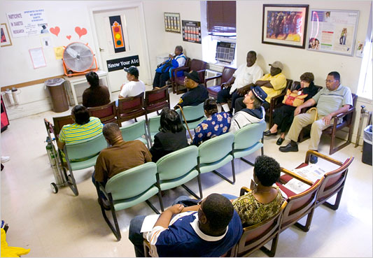
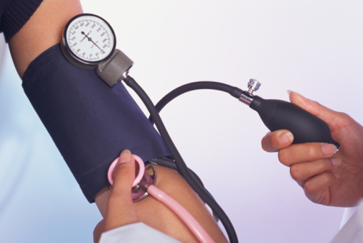
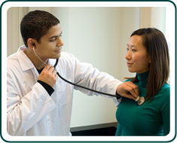
Preventive Healthcare
Annual Physical Exams
What is the process?
Notes:
Show Slide 9. Ask participants:
What do you expect to happen when you go for an annual physical exam? Write down these expectations on the white board and newsprint.
Once they share what they know, describe the process of going to a medical professional for an annual physical exam.
You walk into the office check in with the receptionist.
When it is your turn, a nurse will call your name. You will follow her (or him) and they weigh you. (Why do they weight you? Weight affects diabetes and heart disease.)
Then they take your blood pressure (heart disease)
Draw blood for a blood test (measures cholesterol or fat in blood which indicates heart disease, measures sugar level for diabetes, etc.)
You have an ob-gyn exam (to detect cervical cancer)
Breast exam (breast cancer)
Listen to your heart (heart disease)
Listen to your lungs (lung health, asthma)
Check your mouth and teeth (bad teeth can cause infections)
Based on your health and age the doctor may tell you that you need additional exams.

Slide 10

Preparing for your Doctor’s Visit
Notes:
Show Slide 10. Press play to show the video (Preparing for Your First Doctor’s Visit, 4:07). Then facilitate a discussion using the following questions:
What did you learn from the video?
Was anything surprising to you?
How is this similar or different from what you have experienced in the past?
Is anything shown in the video confusing or difficult to understand?
https://www.youtube.com/watch?v=58ZzCfiS9w0

Slide 11
Breast Cancer
Cervical Cancer
High Blood Pressure
Preventive
Healthcare
Domestic Violence
Diabetes
Recommended Tests
Depression
Osteoporosis
Sexually Transmitted Infections
Notes:
Distribute handout 2.2.2: COMMON HEALTH CONDITIONS AND PREVENTIVE TESTS
Show Slide 11. Tell the participants:
In this section, we will focus on some common health conditions, what the most recommended preventive tests are, and how they help. U.S. medicine recommends that women should be screened regularly for the following serious health conditions.
Click to show all the health conditions. Tell the participants that we will go through each condition in more detail.

Slide 12
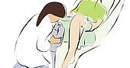
Cervical Cancer
What is cervical cancer?
Age 21-29: Every 3 years
What is a pap test?
Have you ever had a pap test?
Age 30-64: Every 5 years with an HPV test, or every 3 years
How often should you get a pap test?
Age 65+: Ask your doctor
Notes:
Show Slide 12 on Cervical Cancer.
Ask participants: What is cervical cancer?
The cervix is the lower part of the uterus (womb) that opens into the vagina. Cervical cancer occurs when abnormal cells on the cervix grow out of control.
Most cervical cancer is caused by a virus called human papillomavirus, or HPV.
Symptoms of cervical cancer may include:
Bleeding from the vagina that is not normal, such as bleeding between menstrual periods, after sex, or after menopause.
Pain in the lower belly or pelvis.
Pain during sex.
Vaginal discharge that isn't normal.
What is a pap test?
A Pap test checks the cervix for abnormal cell changes. Cervical cancer can almost always be prevented, and having regular Pap tests is the key.
Have you ever had a pap test? Get feedback from participants about what their experience was like.
How often should you have a pap test?
If between ages 21 and 29, get a Pap test every 3 years.
If between ages 30 and 64, get a Pap test and human papillomavirus (HPV) test together every 5 years, or a Pap test alone every 3 years.
If 65 or older, have a doctor assess the medical necessity of Pap tests.

Slide 13
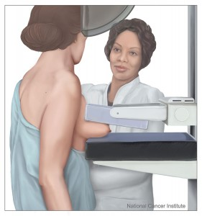
Breast Cancer
What is breast cancer?
Age 50-74: Every 2 years
What is a mammogram?
Have you ever had a mammogram?
How often should you get a mammogram?
Why are mammograms important?
Yes! Early detection of breast cancer saves about 200,000 lives annually!
Do mammograms work?
Notes:
Show Slide 13 regarding Breast Cancer. Ask participants:
What is breast cancer?
Breast cancer starts when cells in the breast begin to grow out of control. These cells usually form a tumor that can often be seen on an x-ray or felt as a lump. The tumor is cancerous if the cells can grow into (invade) surrounding tissues or spread (metastasize) to distant areas of the body..
What is a mammogram?
A mammogram is a low-dose x-ray exam of the breasts to look for abnormalities. A mammogram allows the doctor a closer look at breast tissue than can be felt during a physical breast exam alone.
Have you ever had a mammogram?
Allow participants to answer. Get feedback from participants about what their experience was like.
How often should you have a mammogram?
It is recommended that women younger than age 50 should talk to a doctor about when to start and how often to have a mammogram.
If you are 50 years old or older, every two years.
Why are mammograms important?
Mammograms are the best breast cancer screening tests we have at this time.
Do mammograms work?
Yes! Early detection of breast cancer saves about 200,000 lives annually!

Slide 14
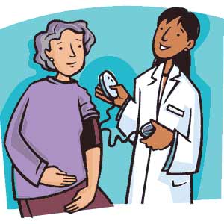
High Blood Pressure
What is high blood pressure?
What factors increase your chances for high blood pressure?
Have you ever had your blood pressure checked?
How often should you have your blood pressure checked?
Whenever you see a doctor or medical professional
Notes:
Show Slide 14 regarding High Blood Pressure. Ask the following questions:
What is high blood pressure?
"Blood pressure" is the force of blood pushing against the walls of the arteries as the heart pumps out blood. If this pressure rises and stays high over time, it's called high blood pressure. With high blood pressure, or hypertension, the blood can't flow easily through blood vessels to organs, and heart attack, stroke, eye problems or kidney problems can ensue.
What factors increase your chances for high blood pressure?
Some things increase chances of having high blood pressure, including increasing age (middle aged or older); diabetes; obesity (or being overweight); eating too much salt; family history of high blood pressure; and lack of exercise.
Have you ever had your blood pressure checked?
Allow participants to answer. Get feedback from participants about what their experience was like.
How often should you have your blood pressure checked?
All women should have their blood pressure levels checked regularly, whenever they see a doctor or other medical professional.

Slide 15



Diabetes
Somali immigrants are developing diabetes
What is diabetes?
What factors increase your risk for diabetes?
Notes:
Show Slide 15 regarding diabetes. Ask the following questions:
What is diabetes?
Diabetes is a disease caused by high levels of blood sugar (glucose) in the body. This can happen when the body fails to produce insulin to properly regulate blood sugar levels. If the body does not make enough insulin, or fails to use the insulin correctly, glucose builds up in the blood. Over time, this extra glucose can lead to prediabetes or diabetes. Diabetes puts you at risk for other serious and life-threatening health problems, such as heart disease, stroke, blindness, and kidney damage. A blood test will assess a person’s risk for diabetes.
Dr. Mehmood Khan, a consultant in the Mayo Clinic’s Division of Endocrinology reports that: “a growing number of Somali immigrants are developing [Type 2 diabetes] within five years, and some as quickly as six months, after their arrival in this country.” Why do you think this is happening?
This can prompt a brief discussion on the food differences/choices and lifestyle differences.
What factors increase your risk for diabetes?
Dr. Khan attributed the phenomenon to a lack of exercise and a dramatic increase in fat and calorie intake experienced by Somali immigrant.
Other risk factors for diabetes include: being overweight, being sedentary, and genetic predispositions.

Slide 16
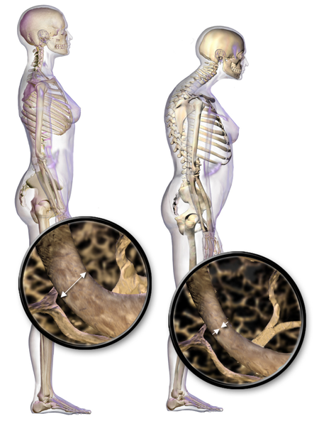
Osteoporosis
What is osteoporosis?
What factors increase your chances for osteoporosis?
Have you ever had your bone density checked?
When should you have bone density checked?
When you are 65 or older
Notes:
Show Slide 16 regarding osteoporosis. Ask the following questions?
What is osteoporosis?
Osteoporosis is a disease of the bones. People with osteoporosis have bones that are weak and break easily.
What factors increase your chances for osteoporosis?
Risk factors for osteoporosis include older age, being a woman, family history of osteoporosis, smaller bone structure and body weight, previous broken bones, being of Caucasian or Asian descent, arthritis and other joint and bone diseases, some medications, smoking, and alcohol use.
Have you ever had your bone density checked?
Allow participants to answer. Get feedback from participants about what their experience was like.
When should you have bone density checked?
Diagnostic testing can assess bone density, an indicator of bone strength or weakness. If 65 or older, a bone density test to screen for osteoporosis is recommended. If younger than 65 but risk factors for osteoporosis exist, a medical professional should be consulted to determine the necessity of testing.

Slide 17
Sexually Transmitted Infections
Some can be cured, others can be medically managed
What are sexually transmitted infections?
Are sexually transmitted infections treatable?
Talk with your medical professional
When should you be tested for sexually transmitted infections?
Notes:
Show Slide 17 regarding sexually transmitted infections. Ask the following questions:
What are sexually transmitted infections?
An STI is an infection passed from one person to another through sexual contact. An infection occurs when bacteria, viruses, or parasites enter the body and grow.
To reduce your risk: abstinence, mutual monogamy, vaccination, and condom use.
Are sexually transmitted infections treatable?
Some STIs can be cured while others cannot STIs that cannot be cured are often able to be medically managed.
When should you be tested for sexually transmitted infections?
A medical professional should be consulted to determine necessity and frequency of testing.

Slide 18
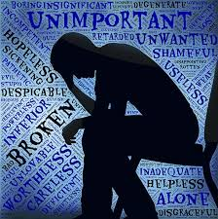
Depression
What is depression?
What are the symptoms of depression?
What are the risk factors for depression?
How is depression treated?
Talk therapy and medication
Notes:
Show Slide 18 regarding depression. Ask the following questions:
What is depression?
Depression (major depressive disorder or clinical depression) is a common but serious medical condition. It causes severe symptoms that affect how you feel, think, and handle daily activities, such as sleeping, eating, or working. Depression can happen at any age, but often begins in adulthood.
What are the symptoms of depression?
Persistent sad, anxious, or "empty" feelings
Feelings of hopelessness and/or pessimism
Feelings of guilt, worthlessness, and/or helplessness
Irritability, restlessness
Loss of interest in activities or hobbies once pleasurable, including sex
Fatigue and decreased energy
Difficulty concentrating, remembering details and making decisions
Insomnia, early-morning wakefulness, or excessive sleeping
Overeating, or appetite loss
Thoughts of suicide, suicide attempts
Persistent aches or pains, headaches, cramps or digestive problems that do not get better, even with treatment
What are the risk factors for depression?
Personal or family history of depression
Major life changes, trauma, or stress
Certain physical illnesses and medications
How is depression treated?
Depression, even the most severe cases, can be treated. The earlier that treatment can begin, the more effective it is. Depression is usually treated with medications, psychotherapy, or a combination of the two.

Slide 19
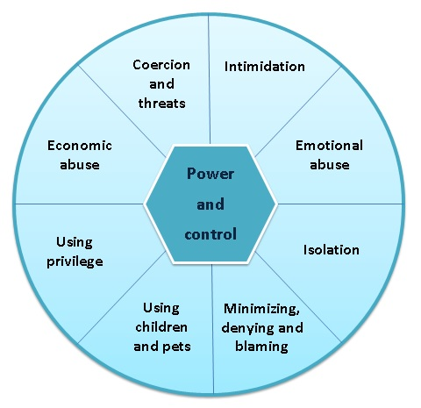
Domestic Violence
What is domestic violence?
Who is a victim of domestic violence?
What are the effects of domestic violence?
Who can you contact to get help?
National Domestic Violence Hotline
1-800-799-7233
Notes:
Show Slide 19 regarding domestic violence. Ask the following questions:
What is domestic violence?
Domestic violence is the willful intimidation, physical assault, battery, sexual assault, and/or other abusive behavior as part of a systematic pattern of power and control perpetrated by one intimate partner against another. It includes physical violence, sexual violence, psychological violence, and emotional abuse. The frequency and severity of domestic violence can vary dramatically; however, the one constant component of domestic violence is one partner’s consistent efforts to maintain power and control over the other.
Signs of domestic violence can include:
Intimidation
Emotional abuse
Isolation
Minimizing, denying, and blaming
Using children and pets
Using privilege or power (male, citizenship)
Economic abuse
Coercion and control
Certain physical illnesses and medications
Who is a victim of domestic violence?
Domestic violence is an epidemic affecting individuals in every community, regardless of age, economic status, sexual orientation, gender, race, religion, or nationality.
What are the effects of domestic violence?
Domestic violence can lead to depression, anxiety, alcohol and drug misuse, STIs, reproductive health issues (such as miscarriage, and stillbirth), nutritional deficiencies, gastrointestinal problems, neurological disorders, chronic pain, disability, hypertension, cancer, and heart disease.
Who can you contact to get help?
Local domestic violence shelters (give information)
The National Domestic Violence Hotline: 1-800-799-7233

Slide 20

Faduma’s Story
Faduma noticed that she had intense pain during and after urination. She has lower back pain and an increased urge to urinate, but when she uses the bathroom only a few drops of urine come out and she feels sharp pains.
She consults her friends. One tells her to drink cranberry juice and eat pineapples, so she does. Her symptoms get worse. Then another friend recommends that she take some herbs. Faduma takes it for five days and her health does not improve.
Notes:
Distribute Handout 2.2.3: FADUMA’s STORY
Show Slide 20: Faduma’s Story. Read the story slowly, and ask participants to listen carefully as they will be in charge of giving advice to Faduma.
Faduma noticed that she had intense pain during and after urination. She has lower back pain and an increased urge to urinate, but when she uses the bathroom only a few drops of urine come out and she feels sharp pains. She consults her friends. One tells her to drink cranberry juice and eat pineapples, so she does. Her symptoms get worse. Then another friend recommends that she take some herbs. Faduma takes it for five days and her health does not improve.

Slide 21
Faduma’s Story
In fact, Faduma is in more pain than ever before to the point she can’t bear the thought of urination. Her favorite cousin gives her a hot pack to help relieve the pain, so she places it on her abdomen for relief. It helps a bit, but as soon as she removes it to go cook dinner, her pain returns full blast.
Finally, she decides to go to urgent care to see a doctor and they prescribe her antibiotics. She takes them for 3 days, begin to feel better, and then stops because she feels better. After a day or two, the pain is back. Faduma is angry at the doctors. They are useless!
In this scenario, what should Faduma do?
Should she stop taking antibiotics if she is feeling better?
Notes:
Show Slide 21: Faduma’s Story. Continue to read the story slowly.
In fact, Faduma is in more pain than ever before to the point she can’t bear the thought of urination. Her favorite cousin gives her a hot pack to help relieve the pain, so she places it on her abdomen for relief. It helps a bit, but as soon as she removes it to go cook dinner, her pain returns full blast. Finally, she decides to go to urgent care to see a doctor and they prescribe her antibiotics. She takes them for 3 days, begin to feel better, and then stops because she feels better. After a day or two, the pain is back. Faduma is angry at the doctors. They are useless!
In this scenario, what should Faduma do?
Facilitate a discussion.
Should she stop taking antibiotics if she is feeling better?
Antibiotics are medications that kill bacteria and prevent it from multiplying. If treatment is not completed in entirety, antibiotics will be insufficient enough to kill all bacteria and it will multiply and the illness will return.
Why should you never give medications prescribed for one person to another person?
Each medicine can be different because of height, weight, and other health issues. Taking or giving individually prescribed medicine to other people is not a good idea and can be potentially harmful.

Slide 22

Closing
What is one ‘take away’ from today’s session?
What questions do you have?
Notes:
Show Slide 22. Thank everyone for coming and participating. Ask the following questions and allow a few minutes for answers.
What is one ‘take away’ from today’s session?
What questions do you have?
Distribute the WORKSHOP EVALUATION FORM. Ask participants to complete and return it to the facilitator.
The facilitator should complete the FIDELITY CHECKLIST AND FACILITATOR FEEDBACK FORM after the completion of the module.

