Slide 1




One Community Program (OCP)
Sponsored by:
Somali Women’s Health Workshop Series
Notes:
Remind the participants about what the One Community Program is (Slide 1).

Slide 2
Female Genital Cutting (FGC) and Health
Module 3
Session 2
Notes:
Introduce the module (Slide 2).

Slide 3
Agenda
Review Learning Objectives
Opening
Health-Related Problems and FGC
Emotional Consequences of FGC
Guest Speaker
Anonymous’ Story
Closing
Notes:
Show Slide 3 and go over the agenda with the participants.
Review of Learning Objectives
Opening
Health-Related Problems and FGC
Emotional Consequences of FGC
Guest Speaker
Anonymous’ Story
Closing and Workshop Feedback

Slide 4
Learning Objectives
Describe the health consequences of FGC
Describe the emotional consequences of FGC
Practice asking questions of a health care provider regarding women’s health and FGC
Discuss what you can do to manage any health consequences of FGC
Notes:
4. Review the learning objectives, shown on Slide 4, with the participants.
Describe the health consequences of FGC
Describe the emotional consequences of FGC
Practice asking questions of a health care provider regarding women’s health and FGC
Discuss what you can do to manage any health consequences of FGC

Slide 5
Where do you fall on the spectrum?
Shortest to tallest
Least to most letters in your name
Least to most children
Least to most siblings
Notes:
Slide 5, Where on the Spectrum?, is an opening icebreaker activity. The goal of this icebreaker activity is to warm up the conversation among the participants. The activity should provide an opportunity for participants to learn something about each other and the facilitator. The facilitator should be prepared to also have an answer to these questions.
The goal of this game is for players to reorder themselves as quickly as possible:
Shortest to tallest
Least to most letters in your name
Least to most children
Least to most siblings
Talk with the group about how they determined the orders – did they talk to each other, measure each other, etc. Ask if this would have been as easy earlier in the workshop.

Slide 6
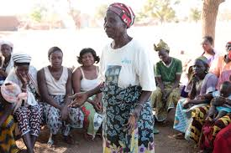
What happens immediately after a girl is circumcised?
Have you or anyone you know experienced any health problems from being circumcised?
Notes:
Distribute Handout 3.2.1: FGC AND HEALTH-RELATED PROBLEMS
Show Slide 6 regarding FGC and health-related problems. Remind participants of the Think-Pair-Share directions. Show each question in turn. Let the women share stories and write some of the key concerns/problems on the white board or newsprint. Question and probe if necessary.
What happens immediately after a girl is circumcised?
Have you or anyone you know experienced any health problems from being circumcised?

Slide 7
Health Related Problems
Long Term Problems
Infections
Painful and prolonged menstruation
Problems having sex
Urinary problems
Fistulae
Inadequate treatment
Depression and anxiety
Notes:
Show Slide 7: Health related problems: Long term problems. Ask the participants:
Based on your own experiences, what do you think are some long-term health related problems associated with FGC?
Make connections between what the women shared (and is written on the board) with information on this slide.
Based on health reports and women’s stories themselves, we know that FGC often results in health complications. These include:
Infections
Problems having sex
Fistulae
Depression and anxiety
Painful and prolonged menstruation
Urinary problems
Inadequate treatment

Slide 8
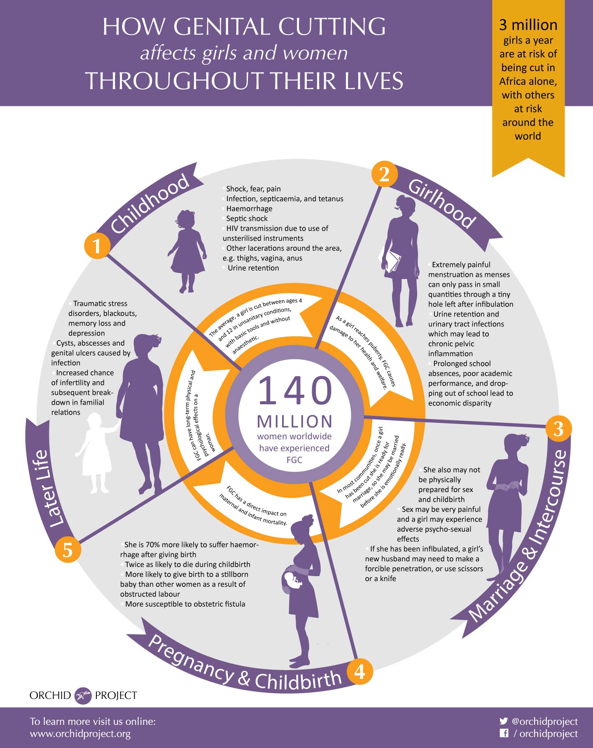
Notes:
Distribute Handout 3.2.2: HOW GENITAL CUTTING AFFECTS GIRLS AND WOMEN THROUGHOUT THEIR LIVES
Show Slide 8: How Genital Cutting Affects Girls and Women Throughout Their Lives. Review the material on the slide, making sure to discuss the long-term effects of FGC throughout the life span.
Childhood
Girlhood
Marriage and Intercourse
Pregnancy and Childbirth
Later Life

Slide 9
Health Related Problems
Problems with pregnancy & childbirth
Infertility
Higher risk for episiotomy
Prolonged labor
Higher risk for cesarean section
Excessive bleeding
Risks to the infant
Notes:
Show Slide 9: Health Related Problems: Problems with pregnancy and childbirth. Ask the participants:
What problems associated with pregnancy and childbirth are common in women with FGC?
Allow the participants to answer based on their own experiences and what they have learned so far. Write answers on the white board or newsprint.
Show the most common problems associated with pregnancy and childbirth.
Infertility
Prolonged labor
Excessive bleeding
Higher risk for episiotomy
Higher risk for a cesarean section
Risks to the infant

Slide 10
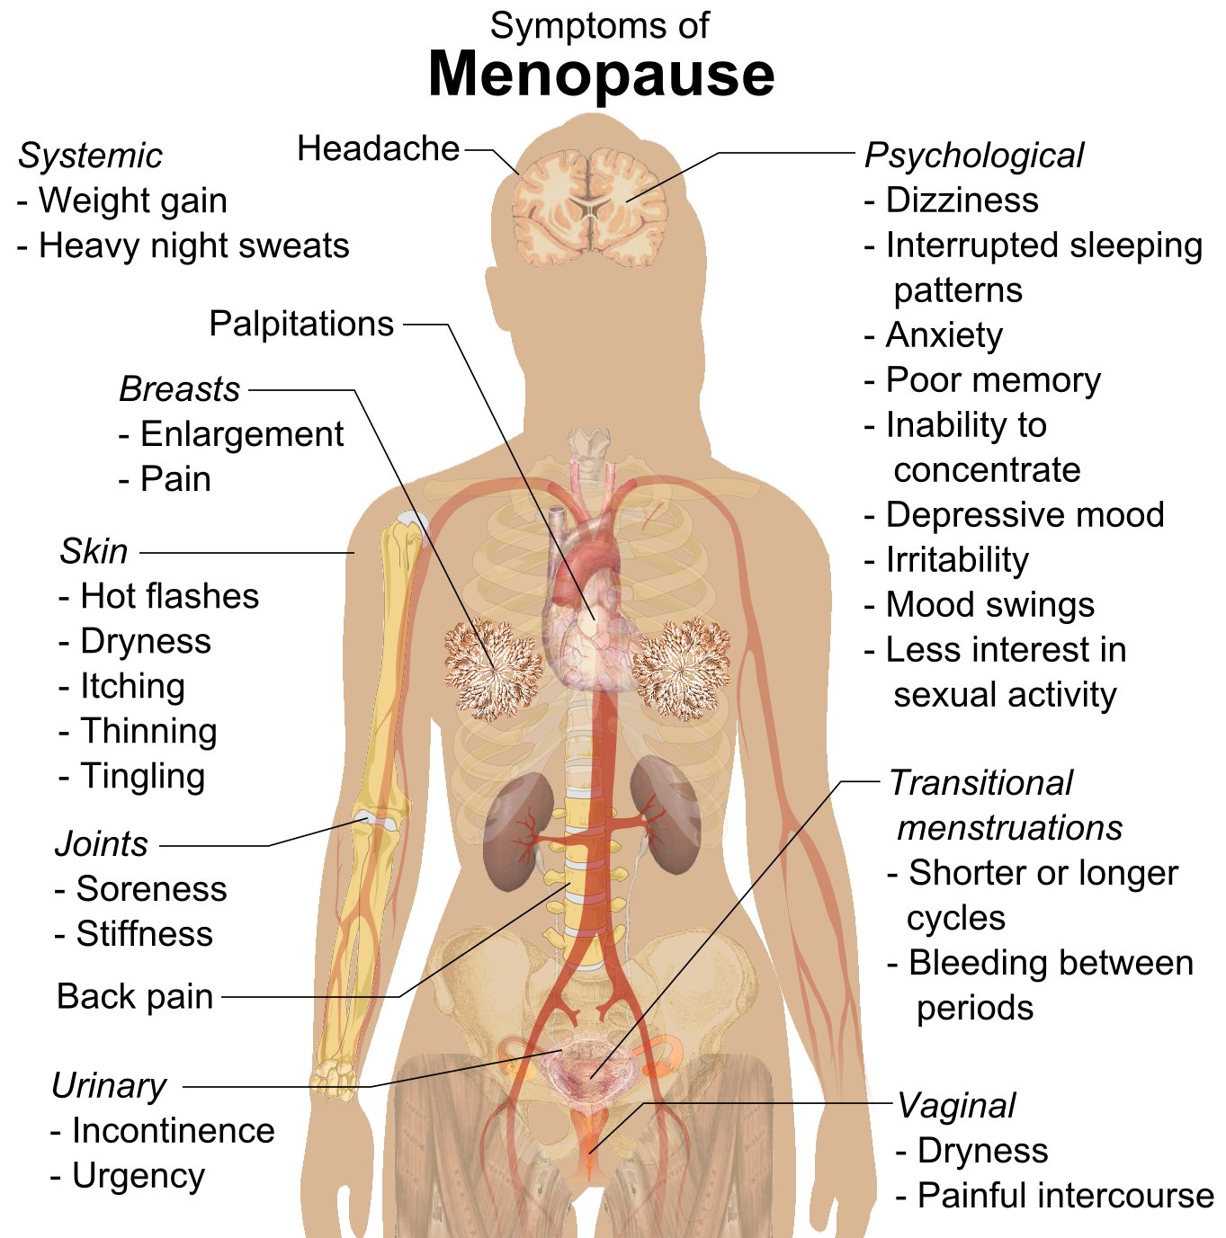
Health Related Problems
Menopause
What is menopause?
What are the symptoms of menopause?
Notes:
Show Slide 10: Health Related Problems: Menopause. Ask the following questions and write the responses of the participants on the white board or newsprint.
What is menopause?
What are the symptoms of menopause?
The first sign is an irregular menstrual cycle. Once a cycle becomes off-schedule, it should stop completely within about 4 years.
Symptoms include mood swings, lower sex drive, hot flashes, sweating, racing heart, headaches, vaginal dryness and soreness, painful sex, and trouble sleeping.
Vaginal atrophy is a thinning, drying, and inflammation of the vaginal walls due to having less estrogen.
Menopause causes the vagina to become smaller, shorter, and lose the typical folds (rugae); the vaginal skin is more brittle and prone to friction, causing bleeding. Intercourse is more painful, and women are more prone to infection.
Vagina shrinking symptoms include: vaginal dryness, itching or burning, painful intercourse, urinating more often, painful urination (dysuria), and passing urine unintentionally during the night.
How does FGC affect menopause?
Discuss with the women how these symptoms can interact with FGC complications.

Slide 11
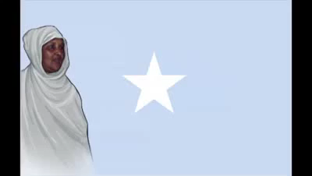
Gabayga Dardaaran dhibta dumarka haysata
Marxuumad Saado Cali Warsame
Notes:
Show Slide 11. Tell the participants, We are going to discuss the emotional consequences of FGC. To begin, we are going to listen to the words of women who have experienced FGC through song and poems. Ask the women to listen to the song and pay attention to how it might fit with their own experience. Introduce the song by saying that it is a song asking Somali men to rethink their mother’s rights. Press play to show the video (Gabayga Dardaaran dhibta dumarka haysata Marxuumad Saado Cali Warsame – 5:18).
https://www.youtube.com/watch?v=OURxhWfTeeI

Slide 12
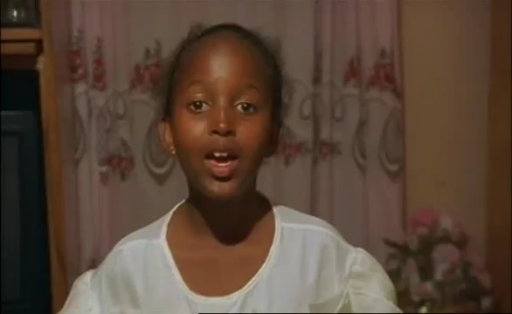
The Day I Will Never Forget: Poem
Notes:
Show Slide 12. Tell the participants that this poem is recited by a young Somali girl, describing the day she was cut. Ask them to listen to the poem and pay attention to how it might fit with their own experience. Press play to show the video (The Day I Will Never Forget – 4:00). https://www.youtube.com/watch?v=vP5ibwSAkBs

Slide 13
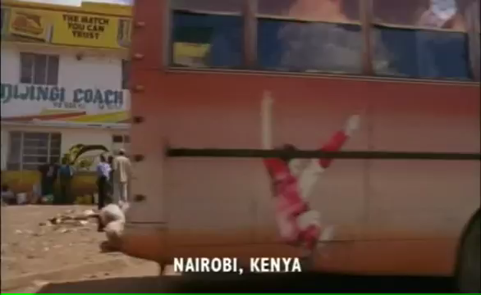
The Day I Will Never Forget: Video
Notes:
Show Slide 13. Tell the participants that this video is a segment from a documentary, "The Day I Will Never Forget." It is a featured documentary by filmmaker Kim Longinotto that examines the practice of FGC. Women speak candidly about the practice and explain its cultural significance within society. This video shows an older woman describing, in Somali, how she cut girls Ask them to listen to the poem and pay attention to how it might fit with their own experience. Press play to show the video (The Day I Will Never Forget – 3:15) https://www.youtube.com/watch?v=gKaRMwO5lFw

Slide 14
Bar Baa Igu Taala aan Weligeed Tirmayn
(I have (harbor) a mark that can never be erased)
Halima Cali Warsame, Garowe District
Reported and Translated By: Dr Asha Mohamud
Notes:
Show Slide 14. Tell the participants that you will read a poem entitled, Bar Baa Igu Taala aan Weligeed Tirmayn (I have (harbor) a mark that can never be erased). It tells of the FGC experience of Halima Cali Warsame

Slide 15
Toban anoon gaarin tabar weyna aan lahayn;
(Before I reached ten and was not so strong)
Tooray igu qalatay habar aan tacliin labarin;
(An old uneducated woman cut me with a knife)
Qodaxday igu taagtay hilibkay tiqtiqahayeen;
(Piercing me with thorns to tightly suture the flesh)
Tiftii Kaadida wadnaha tash layga yiri oo;
(My heart was pierced with the first drops of urine)
Bar baa igu taala aan weligeed tirmayn.
(I have a mark that can never be erased)
Notes:
Show Slide 15. Read the poem.
Toban anoon gaarin tabar weyna aan lahayn;
(Before I reached ten and was not so strong)
Tooray igu qalatay habar aan tacliin labarin;
(An old uneducated woman cut me with a knife)
Qodaxday igu taagtay hilibkay tiqtiqahayeen;
(Piercing me with thorns to tightly suture the flesh)
Tiftii Kaadida wadnaha tash layga yiri oo;
(My heart was pierced with the first drops of urine)
Bar baa igu taala aan weligeed tirmayn.
(I have a mark that can never be erased)

Slide 16
Markaan taaba qaaday oon taladiisa guur u kacay;
(When I grew up and prepared for marriage)
Salaanta utaagay toolmanahaan jeclaa;
(When I raised my hand to greet my handsome love)
Tacab qaadashiyo gurigii mar laysla tegay;
(When we collected our house hold goods and entered our home)
Taabashaddii horeba wadnaha tash layga yiri;
(My heart was pierced with the first touch)
Bar baa igu taala aan weligeed tirmayn.
(I have a mark that can never be erased)
Notes:
Show Slide 16. Continue to read the poem.
Markaan taaba qaaday oon taladiisa guur u kacay;
(When I grew up and prepared for marriage)
Salaanta utaagay toolmanahaan jeclaa;
(When I raised my hand to greet my handsome love)
Tacab qaadashiyo gurigii mar laysla tegay;
(When we collected our house hold goods and entered our home)
Taabashaddii horeba wadnaha tash layga yiri;
(My heart was pierced with the first touch)
Bar baa igu taala aan weligeed tirmayn.
(I have a mark that can never be erased)

Slide 17
Tiftii igu gorordhay tarantii Ilaah alkumay;
(When God created a life out of the few drops that managed to get in)
Talalka cudurka tiiraanyadii walaca;
(When I suffered with the morning sickness)
Markay taarikhdii dhamatay ee fooshii timi;
(when the time finished and labor came)
Tooray looqaaday hilibkii marhore la tolay;
(A knife was taken for the already sutured flesh)
Tararacidd jiirka wadnaha tash layga yiri;
(My heart was pierced with the tearing skin)
Barbaa igu taala aan weligeed tirmayn
(I have a mark that can never be erased)
Notes:
Show Slide 17. Continue to read the poem.
Tiftii igu gorordhay tarantii Ilaah alkumay;
(When God created a life out of the few drops that managed to get in)
Talalka cudurka tiiraanyadii walaca;
(When I suffered with the morning sickness)
Markay taarikhdii dhamatay ee fooshii timi;
(when the time finished and labor came)
Tooray looqaaday hilibkii marhore la tolay;
(A knife was taken for the already sutured flesh)
Tararacidd jiirka wadnaha tash layga yiri;
(My heart was pierced with the tearing skin)
Barbaa igu taala aan weligeed tirmayn
(I have a mark that can never be erased)

Slide 18
Towsda cudurkaasana iilkaan la tagahayaa; ee
(I will take its (FGM/FGC) consequences to the grave)
Taa nawada qaaday gabdhihiina uga tura.
(Save your girls from this that engulfed us all!)
Notes:
Show Slide 18. Finish the poem.
Towsda cudurkaasana iilkaan la tagahayaa; ee
(I will take its (FGM/FGC) consequences to the grave)
Taa nawada qaaday gabdhihiina uga tura.
(Save your girls from this that engulfed us all!)

Slide 19
Group Discussion
What do you think about the song, poems, and video?
What do you think are the emotional consequences of FGC?
What would you tell a girl or young woman about the emotional consequences of FGC if she was being pressured to undergo FGC?
Notes:
Distribute Handout 3.2.3: EMOTIONAL CONSEQUENCES OF FGC
Show Slide 19. Ask the participants the following questions. Encourage all groups to provide responses to the questions. Record key findings, as well as if the group came to a consensus on any of these questions.
What do you think about the song, poems, and video?
What do you think are the emotional consequences of FGC?
What are some emotional consequences to FGC that you or other women you know experienced?
What would you tell a girl or young woman about the emotional consequences of FGC if she was being pressured to undergo FGC?

Slide 20

Guest Speaker
Notes:
Show Slide 20 introducing the guest speaker.
Introduce the guest speaker, who is a trained medical professional (a nurse or OB-GYN preferably).
The guest speaker will share her medical training and experience with FGC, comment on the presentation, and talk about the health issues she most often encounters related to FGC.
The guest speaker will then invite questions and provide answers.

Slide 21
Anonymous’ Story
"I was six years old when it happened to me. I knew what was going to happen, I knew they were going to cut me because a lot of my friends had had it done and I’d had a look – it was quite normal for girls to have a look at each other. My friends had told me that it was really painful, that it was horrible, so I was terrified. It happened when my mother was away and relatives were looking after me and my sister.
Notes:
Distribute Handout 3.2.4: ANONYMOUS’ STORY
Show Slide 21: Anonymous’ Story. Tell the participants that this is a real story of a 14 year old girl from Somalia currently living in the UK. Read the story slowly, and ask participants to listen carefully.
I was six years old when it happened to me. I knew what was going to happen, I knew they were going to cut me because a lot of my friends had had it done and I’d had a look – it was quite normal for girls to have a look at each other. My friends had told me that it was really painful, that it was horrible, so I was terrified. It happened when my mother was away and relatives were looking after me and my sister.
SOURCE: https://www.brook.org.uk/your-life/female-genital-mutilation-fgm-real-story

Slide 22
Anonymous’ Story
In the morning, when I was at school, they told me it was ‘my time’. My uncle and aunt came to take me from the school. It was my sister’s time too – she was eight years old. The woman who cut us was my grandmother’s sister – and she was going to cut us in a tent near a huge tree. They used ropes to tie our legs apart and there were lots and lots of girls there. I could hear screaming, lots of horrible screaming and there was so much blood. Girls were crying.
Notes:
Show Slide 22: Anonymous’ Story. Continue to read the story slowly.
In the morning, when I was at school, they told me it was ‘my time’. My uncle and aunt came to take me from the school. It was my sister’s time too – she was eight years old. The woman who cut us was my grandmother’s sister – and she was going to cut us in a tent near a huge tree. They used ropes to tie our legs apart and there were lots and lots of girls there. I could hear screaming, lots of horrible screaming and there was so much blood. Girls were crying.

Slide 23
Anonymous’ Story
My sister went first, they cut her then they took her somewhere. I heard she fainted. My grandmother’s sister was cutting so many girls and when my sister had been done, she told her to stand just outside, and the blood was running down her legs, then she fainted. My grandmother was screaming at her sister – asking her how she could do this to her grandchildren. She was terrified that my sister would die. But my great aunt insisted, and they said it was my turn.– he helped carry me back to the cutter.
Notes:
Show Slide 23: Anonymous’ Story. Continue to read the story slowly.
My sister went first, they cut her then they took her somewhere. I heard she fainted. My grandmother’s sister was cutting so many girls and when my sister had been done, she told her to stand just outside, and the blood was running down her legs, then she fainted. My grandmother was screaming at her sister – asking her how she could do this to her grandchildren. She was terrified that my sister would die. But my great aunt insisted, and they said it was my turn.– he helped carry me back to the cutter.

Slide 24
Anonymous’ Story
I ran away – I ran as fast as I could but they sent boys after me and they caught me. They took me legs and my arms and carried me back. One of them was my older brother. They tied me down, I was fighting as hard as I could, but they were stronger. I was screaming. The old woman, my great aunt, used a razor blade – it was clean and new, but there was no anesthetic when she cut me. I have no memory at all of her cutting me – it’s blank. But then another woman came, she was from a different city, and she gave me an injection before they stitched me up.
Notes:
Show Slide 24: Anonymous’ Story. Continue to read the story slowly.
I ran away – I ran as fast as I could but they sent boys after me and they caught me. They took me legs and my arms and carried me back. One of them was my older brother. They tied me down, I was fighting as hard as I could, but they were stronger. I was screaming. The old woman, my great aunt, used a razor blade – it was clean and new, but there was no anesthetic when she cut me. I have no memory at all of her cutting me – it’s blank. But then another woman came, she was from a different city, and she gave me an injection before they stitched me up.

Slide 25
Anonymous’ Story
They tied my legs together the whole way down so I couldn’t open my legs, I was like that for three or four weeks.
I remember my grandmother taking me home and telling me I had to pee, I was terrified. Because my legs were tied I couldn’t sit to pee, so I leaned over on one side and the pain was unbearable. I jumped, and some of the stitches opened. My neighbor, she was in her 30s, said I would have to be sewn up again but my grandmother refused.
Notes:
Show Slide 25: Anonymous’ Story. Continue to read the story slowly.
They tied my legs together the whole way down so I couldn’t open my legs, I was like that for three or four weeks.
I remember my grandmother taking me home and telling me I had to pee, I was terrified. Because my legs were tied I couldn’t sit to pee, so I leaned over on one side and the pain was unbearable. I jumped, and some of the stitches opened. My neighbor, she was in her 30s, said I would have to be sewn up again but my grandmother refused.

Slide 26
Anonymous’ Story
When ...I started having periods, the problems started. I had to go to the doctor and they opened me, so everything is much better, but there are still some problems. Lots of people from my community believe that if you are ‘open’ [haven’t undergone FGM], no man will want to marry you, and they keep telling me that. But I don’t believe that – and in any case, if a man doesn’t want me because I am open, the way Allah made me, then he can go away."
What do you think of the girl’s experience?
What do you think of the last sentence?
Notes:
Show Slide 26: Anonymous’ Story. Continue to read the story slowly.
When ...I started having periods, the problems started. I had to go to the doctor and they opened me, so everything is much better, but there are still some problems. Lots of people from my community believe that if you are ‘open’ [haven’t undergone FGM], no man will want to marry you, and they keep telling me that. But I don’t believe that – and in any case, if a man doesn’t want me because I am open, the way Allah made me, then he can go away.
Ask the participants the following questions. Remind them that they may use the handout to record their answers if they choose. Make sure to pause to allow participants to consider their answers and provide opportunities for all participants to share their answers.
What do you think of the girl’s experience?
What do you think of the last sentence?

Slide 27

Closing
What did you learn from today’s session?
How did you feel about the information?
What questions do you have?
Notes:
Show Slide 27. Thank everyone for coming and participating. Thank the participants for sharing their stories and talking and explain that you understand this is a sensitive topic. Ask the following questions and allow a few minutes for answers.
What did you learn from today’s session?
How did you feel about the information?
What questions do you have?
Distribute the WORKSHOP EVALUATION FORM. Ask participants to complete and return it to the facilitator.
The facilitator should complete the FIDELITY CHECKLIST AND FACILITATOR FEEDBACK FORM after the completion of the module.

