Slide 1




One Community Program (OCP)
Sponsored by:
Somali Women’s Health Workshop Series
Notes:
1. Remind the participants about what the One Community Program is (Slide 1).

Slide 2
Female Genital Cutting (FGC) and the Law
Module 4
Session 1
Notes:
2. Introduce the module (Slide 2).

Slide 3
Agenda
Review Learning Objectives
Opening
Overview of U.S. Legal System
U.S. Law and FGC
Guest Speaker
Ruwayda’s Story
Closing
Notes:
3. Show Slide 3 and go over the agenda with the participants.
Review of Learning Objectives
Opening
Overview of the U.S. court system
U.S. Law and FGC
Guest Speaker
Ruwayda’s Story
Closing and Workshop Evaluation

Slide 4
Learning Objectives
Describe the U.S. court system
Explain why FGC is considered illegal in the U.S.
Describe the legal consequences of performing FGC in the U.S. and abroad
Apply your knowledge about FGC and U.S. law
Notes:
4. Review the learning objectives, shown on Slide 4.
Describe the U.S. court system
Explain why FGC is considered illegal in the U.S.
Describe the legal consequences of performing FGC in the U.S. and abroad
Apply your knowledge about FGC and U.S. law

Slide 5

What is one word that describes your culture?
Notes:
II. Opening (5 minutes)
1. Slide 5 is an opening icebreaker activity. The goal of this icebreaker activity is to warm up the conversation among the participants. The activity should provide an opportunity for participants to learn something about each other and the facilitator.
Divide the meeting participants into groups of four or five people.
The facilitator should ask the question, Please think about your culture and come up with one word to describe it.
Ask participants to share with their group. Have members of the groups question each other about the meaning of their one word.
Ask the participants to share their one word with the larger group. Ask for a volunteer to start and then ask each participant to share their one word that described their culture. Write the words on a white board or newsprint.
Once everyone has shared, reflect back to the group any themes that are present
Ask participants, Is this culture consistent across everyone?
If any lessons regarding FGC are shared, finish this section by restating these lessons.

Slide 6

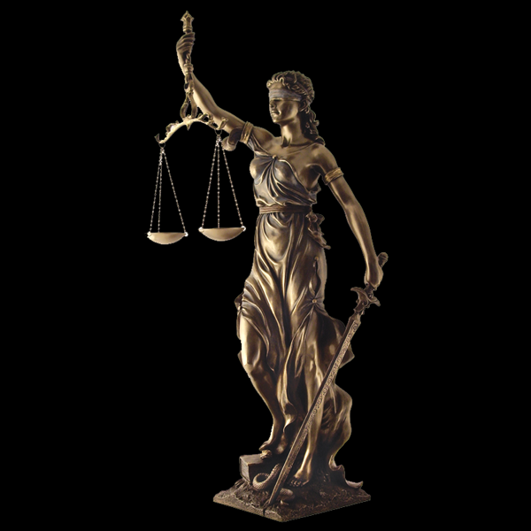
What do you know about the U.S. legal system?
What is surprising or confusing about the U.S. legal system?
Notes:
Note to the instructor: This session deals with serious legal issues. FGC is considered a crime and is illegal under U.S. law. The U.S. system does not aim to “criminalize” the practice of FGC and destroy families by sending parents to prison and taking the children away, but without a doubt, the U.S. legal system will not tolerate FGC performed in the states or abroad by legal residents or citizens.
Distribute handout 2.1.1: UNDERSTANDING U.S. LEGAL SYSTEM.
Show Slide 6 regarding legal system perceptions. Remind participants of the Think-Pair-Share directions. Show each question in turn.
What do you know about the U.S. legal system?
What is surprising or confusing about the U.S. legal system?

Slide 7

Going to Court in the U.S.
Notes:
Show Slide 7. Press play to show the video (Introduction-Going to Court in Minnesota; 7:30). Then facilitate a discussion using the following questions:
What is one thing you learned from the video?
How is the legal or court system different in the U.S. from the system in Somalia?
What is one question you still have about the U.S. legal system?
https://www.youtube.com/watch?v=P-WiHHqZLDs (Somali)
https://www.youtube.com/watch?v=_rw4rf3r510 (English)

Slide 8
U.S. Law and FGC
What American laws are you aware of?
In America, it FGC legal?
No – FGC is against the law in America
Notes:
IV. U.S. Law and FGC (10 minutes)
Show Slide 8. Ask the participants:
What American laws are you aware of?
Write down participant responses on a white board or newsprint. Some examples of laws they may be aware of include laws about children missing school and driving laws. Discuss some similar laws between Somali and American. Then ask the participants:
In America, is FGC legal?
NO -- FGC is against the law in America.
FGC is against the law in the U.S.A. The United States and many other countries consider FGC a violation of women's rights and a form of child abuse. Federal law makes it a crime to perform FGC on a girl younger than 18, or to take, or attempt to take, a girl out of the U.S. for FGC. Yet, girls and women who have experienced FGC, are not at fault and have not broken any U.S. laws

Slide 9
U.S. Law and FGC
What are the laws against FGC in America?
Whoever knowingly transports from the United States and its territories a person in foreign commerce for the purpose of [female genital mutilation] with regard to that person that would be a violation of subsection (a) if the conduct occurred within the United States, or attempts to do so, shall be fined under this title or imprisoned not more than 5 years, or both.
Whoever knowingly circumcises, excises, or infibulates the whole or any part of the labia majora or labia minora or clitoris of another person who has not attained the age of 18 years shall be fined under this title or imprisoned not more than 5 years, or both.
18 U.S. Code § 116 ‘Female Genital Mutilation’
24 states in the U.S. also have laws against FGC
Section 1088 ‘Transport for Female Genital Mutilation’
Notes:
Distribute handout 4.1.2: U.S. GOVERNMENT FACT SHEET ON FEMALE GENITAL MUTILATION OR CUTTING (FGM/C)
Show Slide 9. Recap with participants that FGC may be recognized as a tradition for those who practice it, but in other parts of the world, it is viewed very differently. Ask participants the questions on the slide and engage them in a conversation.
What laws protect girls from FGM in the U.S.?
The federal law addressing FGM in the U.S.: 18 U.S. Code § 116 ‘Female Genital Mutilation’ makes it illegal to Perform FGM in the U.S. or knowingly transport a girl out of the U.S. for the purpose of inflicting FGM.
Whoever knowingly circumcises, excises, or infibulates the whole or any part of the labia majora or labia minora or clitoris of another person who has not attained the age of 18 years shall be fined under this title or imprisoned not more than 5 years, or both.
24 states in the U.S. also have laws against FGM
The states of Arizona, Florida, Georgia, Kansas, Louisiana, Nevada, and New Jersey currently have a “vacation provision” as part of their state laws prohibiting FGM.
Section 1088 ‘Transport for Female Genital Mutilation’
Whoever knowingly transports from the United States and its territories a person in foreign commerce for the purpose of [female genital mutilation] with regard to that person that would be a violation of subsection (a) if the conduct occurred within the United States, or attempts to do so, shall be fined under this title or imprisoned not more than 5 years, or both.

Slide 10
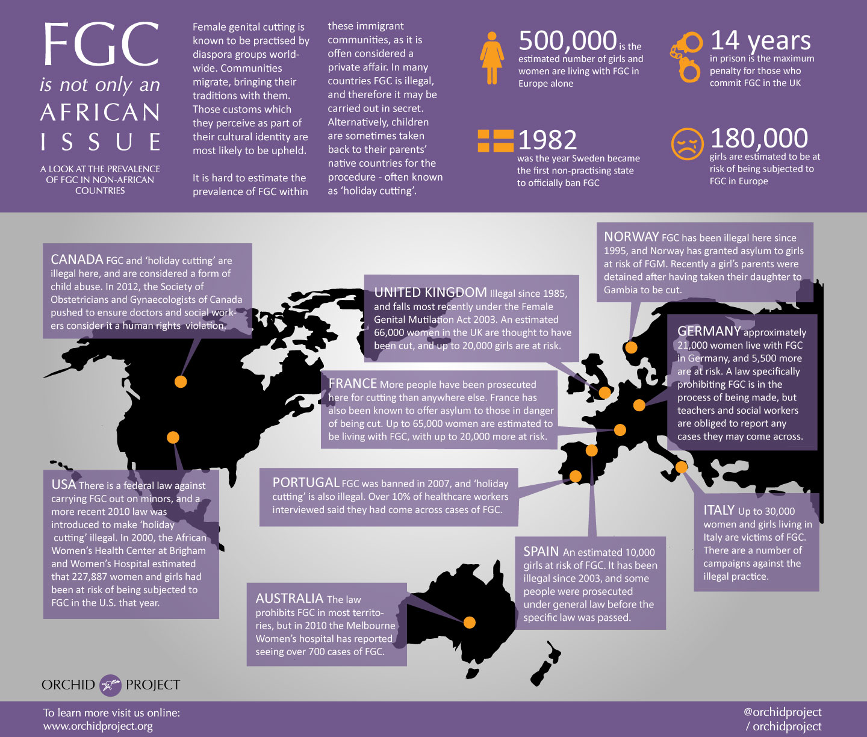
Notes:
Show Slide 10. Review the material on the slide, making sure to discuss legal consequences of FGC throughout the world. Read the consequences of practicing FGC in multiple different countries, stressing the themes across the world including:
That most industrialized countries view FGC as illegal;
‘Vacation cutting’ is also banned in most industrialized countries

Slide 11

U.S. Law and FGC
Why is FGC considered a crime?
Who will be prosecuted?
What are the legal consequences?
Notes:
Show Slide 11: U.S. Law and FGC. For each question, allow participants to answer first, then discuss key points below.
Why is FGC considered a crime?
In the U.S., FGC is considered "child abuse" and the legal ramifications are equivalent. Just as it is illegal abuse a woman or child, "the United States considers FGC to be a serious human rights abuse and a form of gender-based violence and child abuse.7 FGC is therefore considered an aggravated felony and "a violation of women's rights.”
Who will be prosecuted?
All people who helped, organized, transported, assisted, and/or performed FGC. The only person who will not be persecuted is the girl or woman who the procedure was performed on.
What are the legal consequences?
Prison time, family separation, and potential deportation for green card holders and refugees.

Slide 12
U.S. Law and FGC
How does the law affect green card holders and refugees?
If you are a green cardholder or Legal Permanent Resident (LPR)?
If you are a refugee without LPR status?
Notes:
Show Slide 12: U.S. Law and FGC. For each question, allow participants to answer first, then discuss key points below
How does the law affect green card holders and refugees?
Regarding laws, non- citizens (green card holders) are in a more precarious position. If they commit a felony (more serious crime) they can be deported and barred from ever entering the country again.
If you are a green cardholder or Legal Permanent Resident (LPR):
Subject to deportation; may be detained during removal proceedings; subject to up to 20 years in prison if LPR re-enters the U.S. without permission after removal; permanently barred from future immigration to the U.S.; if not removed, LPR may be barred from becoming a naturalized citizen.
If you are a refugee without LPR status:
May be deported after a criminal conviction, even if they would be in grave danger in their home country; some felonies, subject to judicial discretion, may result in the inability to obtain LPR status.

Slide 13
Group Discussion
How do you feel about these regulations?
Do you see FGC as a child abuse?
Do you see FGC as women's right violation?
Notes:
Show Slide 13: Ask the participants the following questions. Encourage all groups to provide responses to the questions. Record key findings, as well as if the group came to a consensus on any of these questions.
How do you feel about these regulations?
Do you see FGC as a child abuse?
Do you see FGC as women's right violation?

Slide 14

Guest Speaker
Notes:
Show Slide 14 introducing the guest speaker.
Introduce the guest speaker, a lawyer or a knowledgeable professional specializing in legal consequences of performing or assisting with FGC.
The guest speaker will share his or her legal experience with FGC, comment on the presentation, and talk about the legal issues she most often encounters related to FGC.
The guest speaker will then invite questions and provide answers.
If a guest speaker is unavailable, then review the U.S. code in more detail. Review state codes as well.

Slide 15
Ruwayda’s Story
Ruwayda was raised by a single mother name Fouzia and her aunt, Khadija. The family has arrived to the country when Ruwayda was just four. Her aunt Khadija is insisting that Ruwayda be circumcised. Fouzia also believes it is the perfect time for Ruwayda to get circumcised before she it is too late. Fouzia has saved up some money for a while and are planning the trip. They told Ruwyada that they will visit Grandma and her dad who are in Somalia.
Notes:
Distribute Handout 4.1.3: RUWAYDA’S STORY.
Show Slide 15: Ruwayda’s Story. Read the story slowly, and ask participants to listen carefully. Mention to the participants that this story introduces a recently arrived Somali family. They have been in the U.S. for less than three years and having hard time adopting to the strange country.
Ruwayda was raised by a single mother name Fouzia and her aunt, Khadija. The family has arrived to the country when Ruwayda was just four. Her aunt Khadija is insisting that Ruwayda be circumcised. Fouzia also believes it is the perfect time for Ruwayda to get circumcised before she it is too late. Fouzia has saved up some money for a while and are planning the trip. They told Ruwyada that they will visit Grandma and her dad who are in Somalia.

Slide 16
Ruwayda’s Story
Ruwayda is very excited for the trip and to fly on the plane. On a late evening, the family take a taxi to the airport and arrive there on time. They board the plane at 7:00pm ct. The family arrive to Mogadishu, Somalia the next day. Fouzia gets hold of her sister Halima and Halima comes over to take them to their big house. Ruwayda is surprised of the beauty of the house.
Notes:
Show Slide 16: Ruwayda’s Story. Continue to read the story slowly.
Ruwayda is very excited for the trip and to fly on the plane. On a late evening, the family take a taxi to the airport and arrive there on time. They board the plane at 7:00pm ct. The family arrive to Mogadishu, Somalia the next day. Fouzia gets hold of her sister Halima and Halima comes over to take them to their big house. Ruwayda is surprised of the beauty of the house.

Slide 17
Ruwayda’s Story
The next night Halima says “I have the best person in town who performed a lot of circumcisions and her name is Faduma”. They all go to visit Faduma and Halima tell her “I have my niece who traveled all the way from America to meet you and help them get circumcised”. Faduma is excited and says it will be $100 for the girl knowing that they can afford this money since they came from U.S.A.
Notes:
Show Slide 17: Ruwayda’s Story. Continue to read the story slowly.
The next night Halima says “I have the best person in town who performed a lot of circumcisions and her name is Faduma”. They all go to visit Faduma and Halima tell her “I have my niece who traveled all the way from America to meet you and help them get circumcised”. Faduma is excited and says it will be $100 for the girl knowing that they can afford this money since they came from U.S.A.

Slide 18
Ruwayda’s Story
After morning prayer, mother tells Ruwayda that they are going to see a lady who will circumcise them and tells her the benefits and beliefs of being cut. Ruwayda accept her mom’s wishes but is in a lot of fear. Ruwayda is in a lot of pain and starts crying and screaming.
Notes:
Show Slide 18: Ruwayda’s Story. Continue to read the story slowly.
After morning prayer, mother tells Ruwayda that they are going to see a lady who will circumcise them and tells her the benefits and beliefs of being cut. Ruwayda accept her mom’s wishes but is in a lot of fear. Ruwayda is in a lot of pain and starts crying and screaming.

Slide 19
Ruwayda’s Story
After a couple of weeks they return back to the U.S. and soon it's time for school. Things were back to normal until Ruwayda got a urinary infection and fever, so Fouzia takes her to see a doctor. Dr. Henderson, a female doctor checks the girl, and notices that the girl has been circumcised.
Notes:
Show Slide 19: Ruwayda’s Story. Continue to read the story slowly.
After a couple of weeks they return back to the U.S. and soon it's time for school. Things were back to normal until Ruwayda got a urinary infection and fever, so Fouzia takes her to see a doctor. Dr. Henderson, a female doctor checks the girl, and notices that the girl has been circumcised.

Slide 20
Ruwayda’s Story
The doctor has known the girl since she first came to the States. The doctor asks Fouzia and the daughter what happened to her genitals and the girl could not lie and said says “My mom and aunt took me to Somalia to get circumcised”.
The doctor looks very serious and tells Fouzia : "I have to report this." Mom is surprised and says “What have I done?
Who can be charged in this story?
What can happen to family?
Why did the doctor report FGC?
What will happen to Ruwayda?
Notes:
Show Slide 20: Ruwayda’s Story. Continue to read the story slowly.
The doctor has known the girl since she first came to the States. The doctor asks Fouzia and the daughter what happened to her genitals and the girl could not lie and said says “My mom and aunt took me to Somalia to get circumcised”.The doctor looks very serious and tells Fouzia : "I have to report this." Mom is surprised and says “What have I done?
Facilitate a discussion for each of the questions. Remind the participants that they can write down their answers on Handout 4.1.3.
Who can be charged in this story?
What can happen to family?
Why did the doctor report FGC?
In the U.S., certain professionals are required to report child abuse. If they see abuse and do not report it, they will be legally liable. This includes social workers; teachers, principals, physicians, nurses; counselors, therapists; child care providers; medical examiners or coroners; and law enforcement officers. Other people who can report are neighbors, family, and friends. The reporting is anonymous, so if a person reports child abuse, they will be protected.
d. What will happen to Ruwayda?

Slide 21

Closing
What did you learn from today’s session?
How did you feel about the information?
What questions do you have?
Notes:
Show Slide 21. Thank everyone for coming and participating. Ask the following questions and allow a few minutes for answers.
What did you learn from today’s session?
How did you feel about the information?
What questions do you have?
Distribute the WORKSHOP EVALUATION FORM. Ask participants to complete and return it to the facilitator.
The facilitator should complete the FIDELITY CHECKLIST AND FACILITATOR FEEDBACK FORM after the completion of the module.
.

