Slide 1




One Community Program (OCP)
Sponsored by:
Somali Women’s Health Workshop Series
Notes:
1. Remind the participants about what the One Community Program is (Slide 1).

Slide 2
Women as Advocates & Leaders
Module 5
Session 2
Notes:
2. Introduce the module (Slide 2). This session is the start of the advocacy and leadership part of the training. The session is focused on positive qualities, capabilities, and strengths of Somali women. It also highlights new generations and what they are achieving in the U.S.

Slide 3
Agenda
Review Learning Objectives
Opening
Positive Traits for Overcoming Challenges
Somali Women Leaders
Leadership Skills
Group Closing Ceremony
Closing
Notes:
3. Show Slide 3 and go over the agenda with the participants.
Review of Learning Objectives
Opening
Positive Traits for Overcoming Challenges
Somali Women Leaders
Leadership Skills
Group Closing Ceremony
Closing and Workshop Evaluation

Slide 4
Learning Objectives
Identify your leadership skills
Review examples of female Somali leaders
Practice leadership skills
Conclude the group
Notes:
4. Review the learning objectives, shown on Slide 4.
Identify your leadership skills
Review examples of female Somali leaders
Practice leadership skills
Conclude the group

Slide 5


What is one GOOD thing that happened today?
What is one BAD thing that happened today?
Notes:
1. Slide 5 is an opening icebreaker activity. The goal of this icebreaker activity is to warm up the conversation among the participants. The activity should provide an opportunity for participants to learn something about each other and the facilitator. The facilitator should be prepared to also have an answer to these questions.
The facilitator should ask the questions: What is one GOOD thing that happened today? What is one BAD thing that happened today?
Pause to allow participants to consider their answers.
Ask participants if they would like to share the information. Allow those that volunteer to share the opportunity to do so. Ask any remaining participants if they would like to share their stories, making sure to ask everyone.
Reflect back to the group any themes that came out.

Slide 6

Positive Traits for Overcoming Challenges
Notes:
Show Slide 6. This activity lets participants learn what others see as their strengths. These traits can be cultivated to increase their advocacy and leadership roles within their community. Have the women pair off. Say the following to the women
You spend the next few minutes sharing with your partner a challenge that you have overcome. It could be a small challenge, such as learning some English phrases, or a big challenge, such as dealing with a loss of a loved one. Both partners should briefly share a challenge they have overcome.
After each person has talked, then each person should share two to four positive or strong qualities of their partner based on how they overcame their challenge.
We will then switch partners and repeat the task.
Once everyone has been in 2-3 pairs (depending on allotted time), have each participant say aloud the traits people said about themselves. Start a discussion asking them if anything surprised them. Use a white board or newsprint to write themes that are uncovered.

Slide 7
Leaders in Somalia and America
What are the characteristics of women from the Somali community?
What do you like about Somali women?
What do you like about American women?
Who are the American and Somali women you admire and why?
Notes:
Distribute Handout 5.2.1: LEADERS IN SOMALIA AND AMERICA
Show Slide 7. Remind participants of the Think-Pair-Share directions and that they can use the handout provided to record their answers if they wish. Show each question in turn. Then facilitate a discussion using the following questions:
What are the characteristics of women from the Somali community?
What do you like about Somali women?
What do you like about American women?
Who are the American and Somali women you admire and why?
After the discussion, summarize their answers, describing qualities of Somali women. Then emphasize that Somali women are recognized as leaders, business owners, and successful professionals throughout the world.

Slide 8
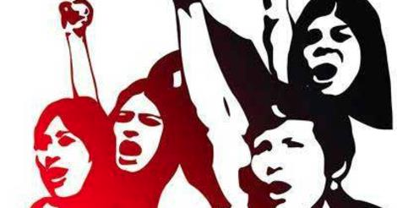
Profiles Of Women Leaders in Somalia and Young Somali Women in The U.S
Notes:
Show Slide 8: Profiles of women leaders in Somalia and young Somali women in the U.S. Share the following with the participants.
There are many strong and passionate Somali women in the world. Some of them are leaders, and some are the first in their community to try new careers. Over the next few slides we will show you some examples of strong female Somali leaders.

Slide 9
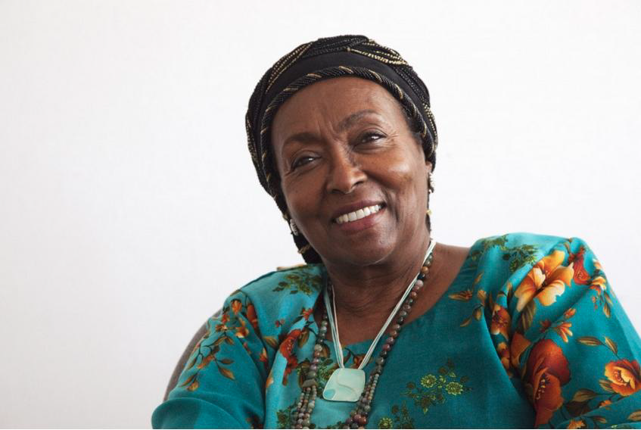
Edna Adan
Notes:
Show Slide 9. Introduce Edna Adan. Share the following with the participants:
Edna Adan (also known as Edna Adan Ismail) is the daughter of a prominent Somali medical doctor. She was trained as a nurse and midwife in the United Kingdom and married Muhammad Haji Ibrahim Egal, a Somali politician who was elected Prime Minister of Somalia in 1967.
In the mid-1980s she began building a hospital in Mogadishu, but the Somali Civil War began and she fled the country. She worked for, and with, the World Health Organization for around a decade before returning to Somalia in the late 1990s. In 2002, she founded the non-profit Edna Adan University Hospital through which she has trained many healthcare professionals and made notable strides in the fight against maternal mortality.
Edna Adan was the only female minister in the Somaliland government until July 2006. She holds an Honorary Doctoral Degree from Clark University in Massachusetts in the U.S.A. and is an Honorary Fellow of Cardiff University’s School of Nursing in Wales, in the United Kingdom. Edna Adan also has been featured in the book and accompanying documentary Half the Sky: Turning Oppression into Opportunity for Women Worldwide and was named among the 100 most influential Africans. She is recognized internationally as a pioneer of women’s health and education.

Slide 10
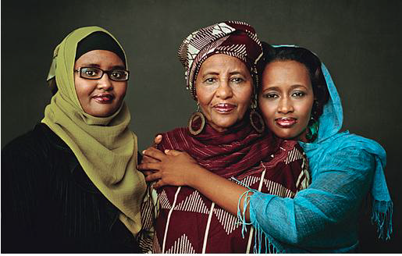
Hawa Adhi
Notes:
Show Slide 10. Introduce Hawa Adhi. Share the following with the participants:
As a 12-year-old, Hawa Abdi lost her mother to complications related to childbirth. Determined to understand why her mother had died, young Ms. Abdi studied medicine and, in 1971, obtained a medical degree. The following year, her grandmother died and Dr. Abdi learned that Somali laws prevented female relatives from inheriting land or other possessions. She immediately took up legal studies and, working as a physician during the day and studying law at night, obtaining a law degree from Mogadishu’s Somali National University in 1979.
After working in Mogadishu for several years Dr. Abdi opened a small clinic on her farm. Within a few years she was providing healthcare to approximately 800 internally displaced families, and over 4,000 people who were living in makeshift homes neighboring her clinic and a nearby Red Cross feeding station. That number quickly grew. By 2009, around 90,000 people were being assisted by Dr. Abdi and people outside of Somalia were increasingly aware of her amazing work. Swiss associates, inspired by Dr. Abdi, established the Association Suisse Hawa Abdi that enabled Dr. Abdi to open a Women’s Education Center at her clinic. What began as a small clinic has grown into a 400-bed hospital, an accompanying school, and a nutrition center. Approximately two million people have been assisted by Dr. Abdi’s facilities since 1983.

Slide 11
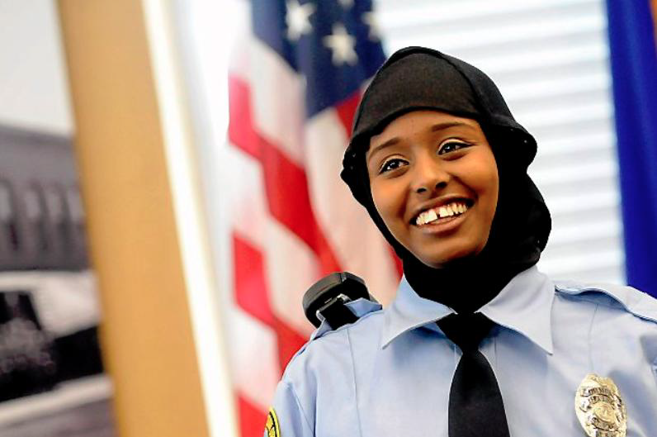
Kadra Mohamed
Notes:
Show Slide 11. Introduce Kadra Mohamed. Share the following with the participants:
“It’s nerve-wracking in a way,” Mohamed, 21, said of being the first woman of Somali descent in the department. “I want to be a good role model for others, especially Somali women. In Somali culture, women don’t strive to become police officers," Kadra Mohamed said. Mohamed was recognized as the first Somali-American woman to join the St. Paul Police Department, a move made possible by the department’s announcement that it has approved an option for employees to wear a police-issued hijab.
A criminal justice senior at St. Cloud State University and a St. Paul Central High School graduate, Mohamed said she contacted St. Paul police a few months ago to learn about becoming an officer. She said she expressed concerns over not being able to wear a hijab on duty. In Islam, females may wear the hijab as a form of modesty and cultural identity, and Mohamed wears it as part of her daily dress.
Mohamed was born in a refugee camp in Kenya in 1991, not long after her parents fled Mogadishu, Somalia's capital, and its nearly daily bombings and strife. Her father, Hassan, was Ethiopian, and he and her Somali mother, Zamzam, were joined by an arranged marriage. The family eventually relocated to the Twin Cities, an area with more than 60,000 Hmong residents and a reputation for welcoming immigrants. The couple had four more children — two boys and two girls.
Mohamed said she is planning to enroll in a police academy to receive officer training after she graduates from St. Cloud State in May. After that, she said, she will apply to become an officer. Some of her tasks as a liaison officer include assisting officers in criminal investigations and extending outreach within the Somali community to bridge cultural gaps, she said.

Slide 12
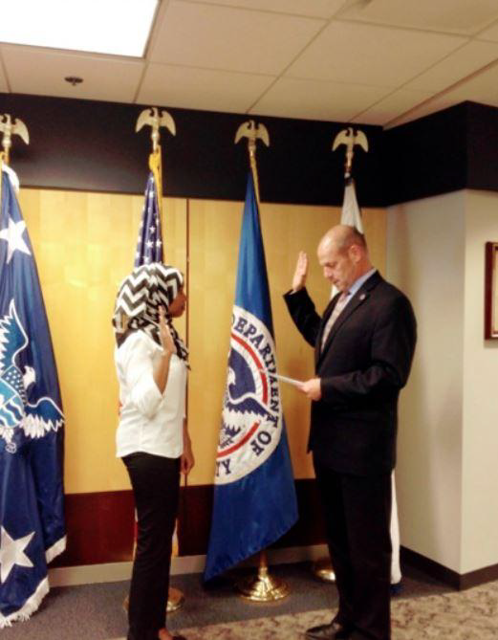
Fatuma Noor
Notes:
Show Slide 12: Introduce Fatuma Noor. Share the following with the participants:
Fatima Noor worked as a special assistant in the Office of the Director for U.S. Citizenship and Immigration Services (USCIS) in the Department of Homeland Security. Fatuma Noor worked for the White House. "Today, I am honored to serve on a White House team advancing the President’s efforts to fix our broken immigration system. I want to show my appreciation to this country, and I can’t think of a better way to do it than by being there for others who want to earn the privilege to celebrate their Day One.“
She was born in Somalia, but was sent to Denmark for kindergarten for her safety. In the early 2000s, her father left Somalia, alone. He came to the United States as a refugee. He eventually settled in Memphis, Tennessee where he started the paperwork to her and her mother and brothers to the U.S. She attended high school in Memphis and eventually graduated from the University of Memphis. Noor majored in psychology with minors in Spanish and international relations. She completed a month-long research fellowship in psychology hosted by Carnegie-Mellon and the University of Pittsburgh. Noor was a leader in many honor societies at the U of M. She has done volunteer work with World Relief Memphis and the Tennessee Immigrant and Refugee Rights Coalition.
On the morning of April 29, 2013, she became a U.S. citizen in the same auditorium in which she graduated high school. On July 28, 2014, she was sworn in as special assistant to the Director of U.S. Citizenship and Immigration Services (USCIS). USCIS naturalizes more than 700,000 new U.S. citizens each year, along with processing millions of other immigration-related requests. USCIS is the very agency that made it possible for her family to immigrate, and for all of us to become citizens. In her position, she coordinated special naturalization ceremonies. These commemorate national holidays or other special events and feature prominent speakers, guests, and locations.

Slide 13
Profiles of Somali Women Leaders
What do you think of these women?
What did they do differently from other Somali women?
What characteristics of Somali women do you see in these women leaders?
What characteristics of these women do you see in yourself?
Notes:
Show Slide 13: Ask the participants the following questions. Encourage all groups to provide responses to the questions. Remind participants that they can use the handout provided to record their answers if they wish. Record key findings on a white board or newsprint, as well as if the group came to a consensus on any of these questions.
What do you think of these women?
What did they do differently from other Somali women?
What characteristics of Somali women do you see in these women leaders?
What characteristics of these women do you see in yourself?

Slide 14
Role Play
You have had a difficult morning. Your sister was going to take care of your children while you went to your OB-GYN appointment, but she called you at the last minute to tell you she was sick and could not babysit. You made a few calls to other family members, but no one was available. You decided to get your children ready and bring them with you to the appointment, which caused you to be late. When you arrived at the clinic, the front desk receptionist frowned and rolled her eyes at you, made loud sighing noises, and informed you in a rude tone of voice: "You are late and the doctor cannot see you". You noticed a sign on the desk that states your appointment will be cancelled if you are over 15 min late, but you are only 10 min late.
What should you do?
Notes:
Show Slide 14. State the following: Some of the keys to advocacy and leadership – particularly in the US – are to be brave, to stand up for yourself, to communicate well, and to not give up easily. Read the following story. After the story, ask what the participants would do. Write down themes on a white board or newsprint.
You have had a difficult morning. Your sister was going to take care of your children while you went to your OB-GYN appointment, but she called you at the last minute to tell you she was sick and could not babysit. You made a few calls to other family members, but no one was available. You decided to get your children ready and bring them with you to the appointment, which caused you to be late. When you arrived at the clinic, the front desk receptionist frowned and rolled her eyes at you, made loud sighing noises, and informed you in a rude tone of voice: "You are late and the doctor cannot see you". You noticed a sign on the desk that states your appointment will be cancelled if you are over 15 min late, but you are only 10 min late.
What should you do?

Slide 15
Role Play
You are a single mother. Your children are in high school planning to go to college. You are tired of struggling for every dollar. Your children offer to help, but they need money for school. You heard that another woman got a part time job as a Certified Nurse Assistant; you wonder if you could do that too. Your aunt, cousins, and mother-in-law, gather in your house and you tell them, "I am thinking of becoming a CNA, so I can work part time and make some money." Your aunt laughs aloud and says: "You a nurse? You do not not know any English! Stay at home and look after your mother-in-law." Your mother-in-law joins in the laughing and says, "Your place is in the house. If your husband were alive he wouldn't let you think about it." Your cousin makes a face and says, "A CNA? You will make no money! I would never do THAT.”
What do you say?
What should you do?
Who is right here?
Notes:
Show Slide 15. Read the following story. After the story, ask what the participants would do. Write down themes on a white board or newsprint.
You are a single mother. Your children are in high school planning to go to college. You are tired of struggling for every dollar. Your children offer to help, but they need money for school. You heard that another woman got a part time job as a Certified Nurse Assistant; you wonder if you could do that too. Your aunt, cousins, and mother-in-law, gather in your house and you tell them, "I am thinking of becoming a CNA, so I can work part time and make some money." Your aunt laughs aloud and says: "You a nurse? You do not not know any English! Stay at home and look after your mother-in-law." Your mother-in-law joins in the laughing and says, "Your place is in the house. If your husband were alive he wouldn't let you think about it." Your cousin makes a face and says, "A CNA? You will make no money! I would never do THAT.”
What do you say?
What should you do?
Who is right here?

Slide 16

Examples of Leadership
What was the situation?
What did you do?
How did you feel afterwards?
Notes:
Show Slide 16. Ask participants for examples when they felt and behaved like a leader or an advocate for themselves. Facilitate a discussion for each of the questions. Make sure to pause to allow participants to consider their answers and provide opportunities for all participants to share their answers.
What was the situation?
What did you do?
How did you feel about it afterward?

Slide 17
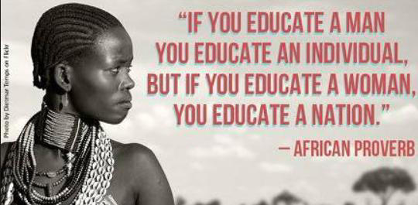
Closing Ceremony
Notes:
Show Slide 17. Say to the participants that you are happy to tell them that they have completed the One Community Program. Spend the next 15 minutes engaging in whatever closing ceremony that the group has decided to perform. Make sure to handout all certificates of completion and get a group picture.

Slide 18

Closing
What do you remember most?
What
was one thing you learned and you can use in your life?
What questions do you have?
Notes:
Show Slide 18. Thank everyone for coming and participating. Ask the following questions and allow a few minutes for answers.
What do you remember most?
What was one thing you learned and you can use in your life?
What questions do you have?
Distribute the WORKSHOP EVALUATION FORM. Ask participants to complete and return it to the facilitator.
The facilitator should complete the FIDELITY CHECKLIST AND FACILITATOR FEEDBACK FORM after the completion of the module.

