Slide 1


The One
Community Program
INTEGRATING THE PREVENTION AND EDUCATION OF HEALTH COMPLICATIONS FROM FGM/C INTO PROVIDERS’ DAILY WORK
Monica Westfall
Munira Salad
Fadumo Hassan
Patricia Stubber, PhD
Dylanna Jackson
Faduma Salah
Bola Mohamed
This material was developed by the Northwest Pennsylvania Area Health Education Center with federal funds from the Office on Women’s Health, U.S. Department of Health and Human services. You may reproduce this material for training and informational purposes.

Slide 2
Today’s Agenda
Agenda | Time
Introduction to the One Community Project | 2-3 minutes
Module 1: Introductions to Female Genital Cutting (FGM/C) | 10 minutes
Module 2: Traditional Beliefs, Values, & Attitudes Towards FGM/C | 10 minutes
Module 3: Complications of FGM/C | 10 minutes
Module 4: Strategies for Involving Individuals, Families, & Communities in the Prevention of FGM/C | 10 minutes
Module 5: Professional Ethics & Legal Implications of FGM/C | 10 minutes
Closing and Workshop Feedback | 5-7 minutes

Slide 3

1. Introduction to Female Genital Mutilation/Cutting (FGM/C)
Learning Objectives
At the end of module 1 participants are expected to be able to:
Identify which ethnic communities practice FGM/C;
Give a description of FGM/C;
Recall the classification system of FGM/C.

Slide 4

Let’s Talk
What do you know about FGM/C?
How would you define it?
“…all procedures that involve the partial or total removal of external genitalia or other injury to the female genital organs for non-medical reasons.” WHO, 2016
Which groups are you familiar with that practice FGM/C?
Do you know how many women have undergone FGM/C?
More than 200 million girls and women alive today have been cut in 30 countries in Africa, the Middle East and Asia where FGM/C is concentrated¹.
WHO 2016 http://www.who.int/reproductivehealth/topics/fgm/management-health-complications-fgm/en/

Slide 5
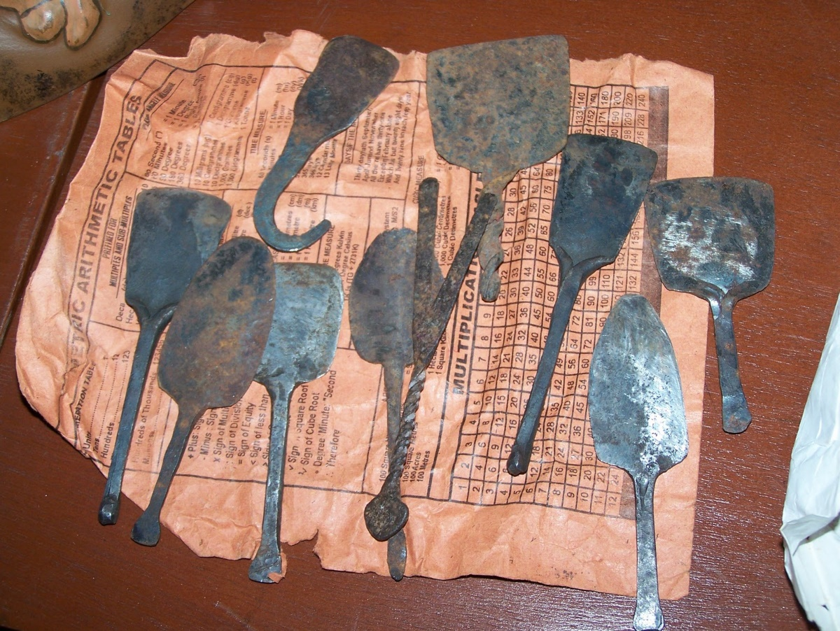
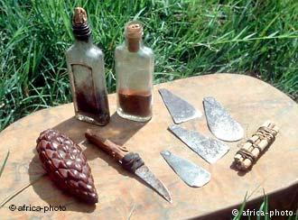
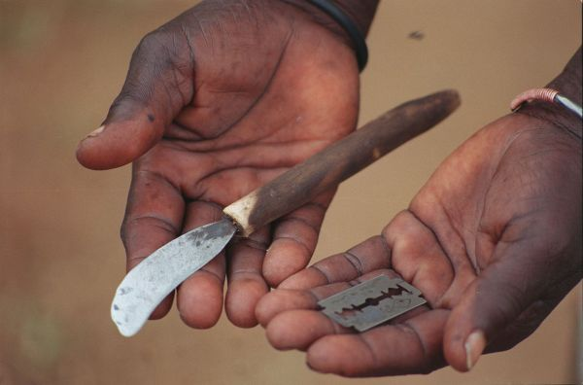
Traditional Tools
FGM/C is carried out using special knives scissors, razors, or pieces of glass.
The operation is usually performed by an elderly woman, a traditional circumciser.
No anesthesia is given.
In some areas, young girls are instructed to pull their labia minora and/ clitoris over a period of 2-3 weeks after the procedure. This keeps the genitalia from reverting back to its original shape.
The age at which FGM/C varies greatly.
It is most commonly occurs to girls between the ages of 4 and 10.

Slide 6
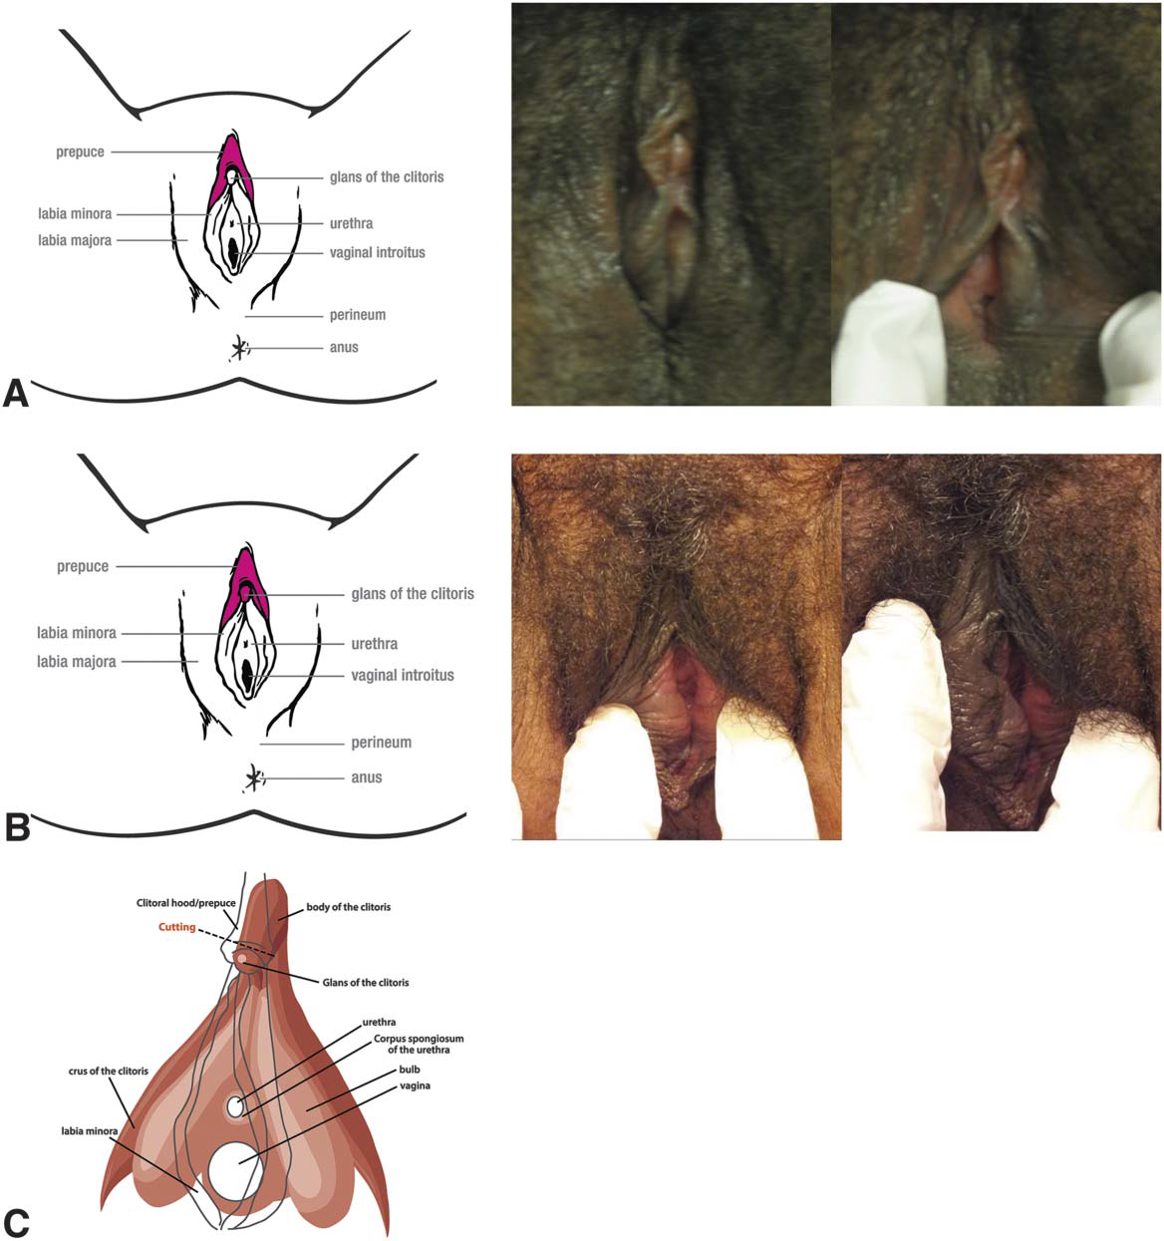
Type 1: Partial or total removal of the clitoris
Type Ia: removal of the prepuce of the clitoris
or clitoral hood (female circumcision)
Type Ib: removal of the clitoris with the
prepuce (clitoridectomy)

Slide 7
Removal of the clitoris
In the World Health Organization (WHO) classification, when there is reference to removal of
the clitoris, only the glans or the glans with part of the body of the clitoris is removed. The recognition of type Ia can be difficult. In Type Ia, an asymmetry of the prepuce can be noticed.

Slide 8
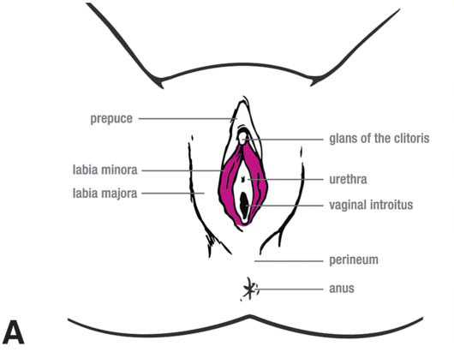
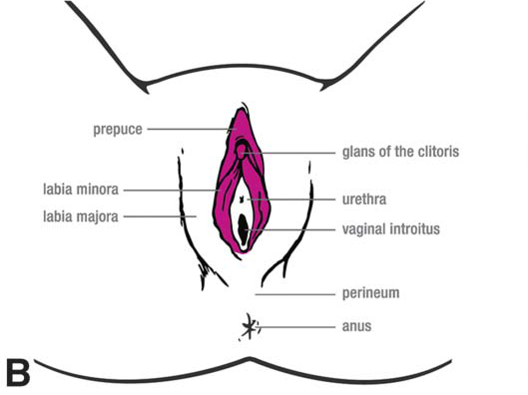
Type II: partial or total removal of the clitoris and the labia minora with or without excision of
the labia majora.
Type IIa: partial or total removal of the clitoris and the labia minora with or without excision of the labia majora.
Type IIb: partial or total removal of the clitoris & labia minora.

Slide 9
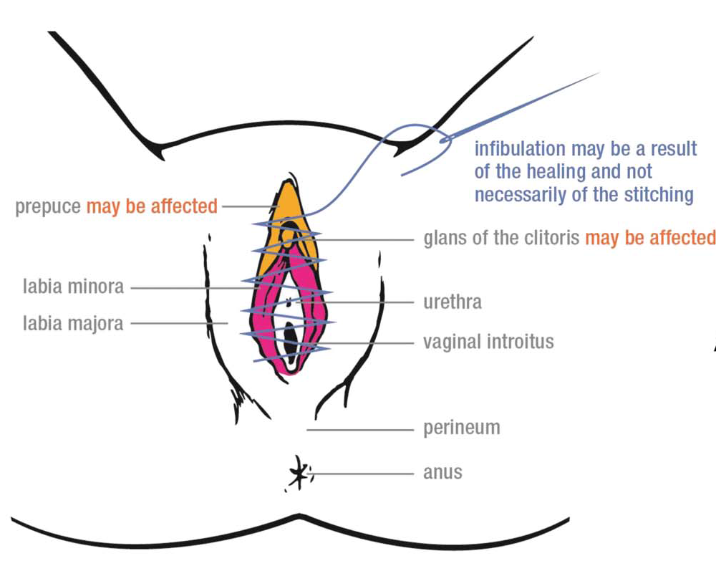
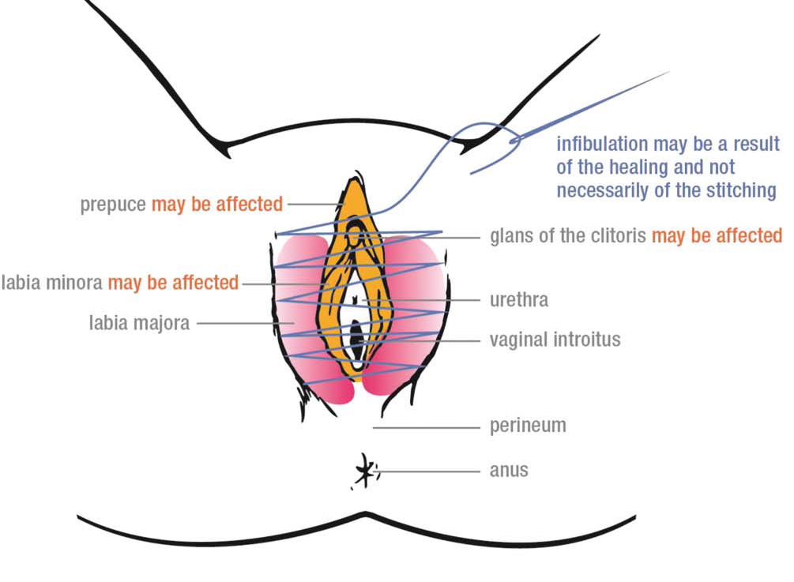
Type III: narrowing of the vaginal orifice with creation of a covering seal by cutting and appositioning the labia minora or the labia majora or both, with or without excision of the clitoris (infibulation)
Type IIIa: removal and appositioning the labia minora with or without excision of the clitoris
Type IIIb: removal and appositioning the labia majora with or without excision of the clitoris

Slide 10
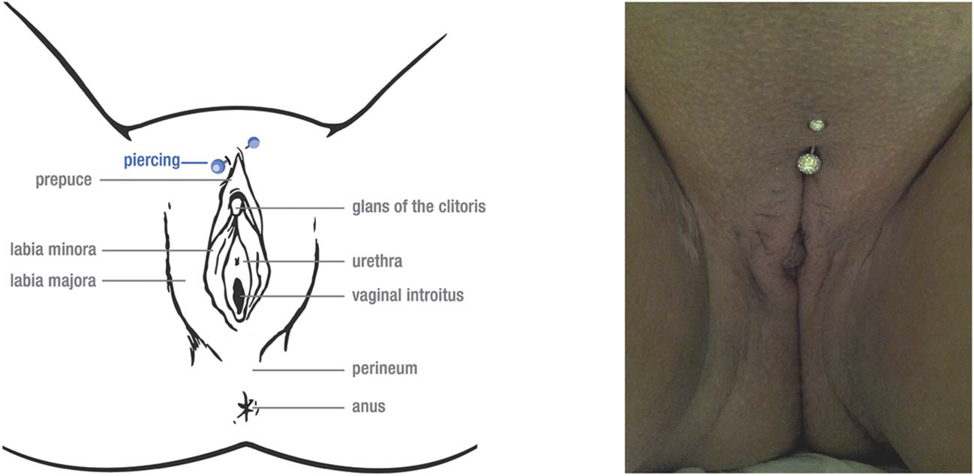
Type IV: All other harmful procedures to the female genitalia for non-medical purposes, for example: pricking, pulling, piercing, incising, scraping and cauterization

Slide 11

The Cut: Exploring FGM - Al Jazeera Correspondent

Slide 12
2. Traditional Beliefs, Values, & Attitudes
Towards FGM/C
Learning Objectives
At the end of module 2 participants are expected to:
Understand the origins of FGM/C;
Identify the reasons FGM/C is practiced.

Slide 13
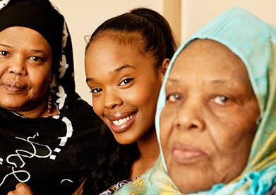
The History
FGM/C mostly carried out by traditional circumcisers, who often play other central roles in communities, such as attending childbirths.
Medicalization of FGM/C is increasing—more than 18% had it performed by a healthcare provider with the rate as high as 74% in some countries (WHO, 2010).

Slide 14
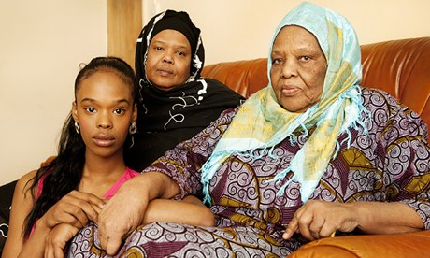
Why Does FGM/C Continue to Happen?
To help ensure a woman remains a virgin until marriage
Hygiene. Some communities believe that the external female genitals are unclean.
Rite of passage. In some countries, FGM/C is part of the ritual that a girl goes through to be considered a woman.
Condition of marriage. In some countries, a girl or woman is cut in order to be suitable for marriage.
Belief that FGM/C increases sexual pleasure for the man
Religious duty, although not in any religion's holy texts.

Slide 15
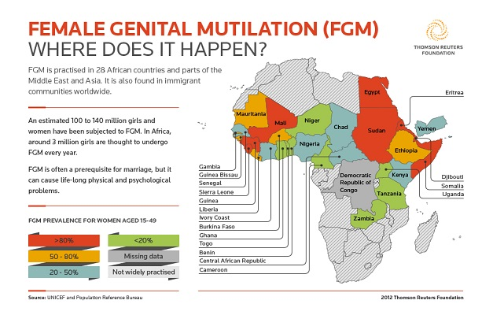
Where does FGM/C Occur?

Slide 16
3. Complications of FGM/C
Learning Objectives
At the end of module 3 participants are expected to be able to:
Describe the immediate and long-term complications of FGM/C;
Identify the appropriate resources to address said complications.

Slide 17
Immediate Medical Complications
Bleeding
  Hemorrhage
  Anemia
  Oliguria
  Shock
Urinary Retention
Musculoskeletal Injuries
  Bruising
  Fractures (humerus, clavicle, femur)
Infection
  Cellulitis
  Abscess
  Septic Shock
  Pelvic Inflammatory Disease
  Tetanus
  Gangrene

Slide 18
Long Term Medical Complications
Urinary
  Urethral Stricture
  Chronic UTIs
Menstrual Difficulty
  Hematocolpos
  Dysmenorrhea
  Endometriosis
Infertility
  Chronic Vaginitis
  PID
Pain
  Neuromas
  Dyspareunia, Vaginismus, Volvodynia, Apareunia
Scarring
  Keloids
  Fibrosis
  Meatal obstruction
  Sebaceous/inclusion cyst
  Vaginal stenosis
Childbirth
  Difficult delivery, higher rate of C-sections
  Post partum hemorrhage
  Complications for baby including need for resuscitation
  Death

Slide 19
Psychological Implications
Fear
Anger
Depression
Anxiety disorders including PTSD

Slide 20
Treating Circumcised Women
Do not prioritize circumcision above patients’ own needs and concern. The visit should remain patient-centered;
Ask questions about circumcision as part of a reproductive history after establishing rapport with the patient;
Women who have complications often do not attribute them to the procedure. Ask women specifically if they have any of the symptoms discussed earlier;
Ask general, nonthreatening questions – do no judge;
Respect the woman's’ modesty during an examination;
Circumcision does not guarantee chastity, teach women about contraception;
Inform women they can defibulate electively for problems, or prior to intercourse or delivery.

Slide 21
4. Strategies for Involving Individuals, Families, & Communities in the Prevention of FGM/C
Learning Objectives
At the end of module 4 participants are expected to be able to
Understand how culture and belief systems connect to community/healthcare access;
Understand how to better identify their patient’s needs and be culturally competent to address them;
Provide support and/or referrals for women and girls who want to prevent FGM/C.

Slide 22
Communicating for Change
Understanding Beliefs
How to Address Them
FGM/C is a religious tradition
An unexcised woman will have an overactive sex drive
If the clitoris touches the baby at birth the baby will die.
Learn the cultural reasons for the beliefs
Advise on the various dimensions of the health consequences
Contribute to the change process
Let’s brainstorm how…
Identify community leaders – understand the male role in FGM/C
Attend community events – gain trust
Integrate education and counseling

Slide 23
Being Culturally Competent
Provide female clinicians and interpreters when possible;
Avoid using family members as interpreters;
Make confidentiality explicit;
Reach out to local organizations to discuss traditional practices and elicit suggestions for how to proceed with sensitive issues;
Understand the role of the interpreter – to only interpret.
Become familiar with your own opinions and emotions before seeing patients;
Remain respectful of your patient’s choice.

Slide 24
5. Professional Ethics & Legal Implications of FGM/C
Learning Objectives
At the end of this module participants are expected to be able to:
Understand the legal implications of performing FGM/C;
Understand the professional ethics and reporting standards.

Slide 25
Professional Ethics
Addressed in the Guiding principles of the WHO guidelines on the management of health complications from female genital mutilation (2016).
Girls and women living with female genital mutilation (FGM) have experienced a harmful practice and should be provided quality health care.
All stakeholders – at the community, national, regional and international level – should initiate or continue actions directed towards primary prevention of FGM.
Medicalization of FGM (i.e. performance of FGM by health-care providers) is never acceptable because this violates medical ethics since:
  FGM is a harmful practice;
  Medicalization perpetuates FGM; and
  The risks of the procedure outweigh any perceived benefit.

Slide 26

Federal Law
1996 Federal Law – 18 U.S.C. 116 FGM “knowingly circumcis[ing], excis[ing], or infibulat[ing] the whole or any part of the labia majora or labia minora or clitoris of another person who has not attained the age of 18 making FGM/C illegal when performed on girls under 18 years old;
Illegal to assist;
Illegal to arrange for “cutting vacations” to the homeland;
If not a citizen, individual can face deportation;
Jail time up to five years;
Loss of license;
Child Protective Laws apply-- https://www.childwelfare.gov/topics/can/defining/federal/

Slide 27
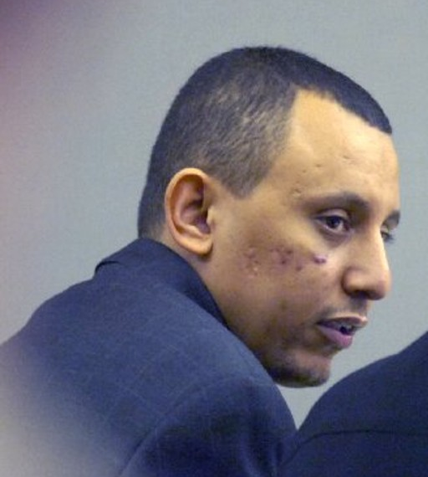
Kahlid Adem - Father
Arrested in 2001 for FGM/C;
Native of Ethiopia, living in Georgia;
Used scissors to cut his 2 y/o daughter’s genitals;
Convicted in November 2006 of aggravated battery and cruelty to children and sentenced to 10 years in prison and five years of probation, according to The Atlanta Journal-Constitution’s archives;
Georgia now has state law prohibiting it, making it a felony;
Deported to his native Ethiopia by ICE March 5, 2017.

Slide 28
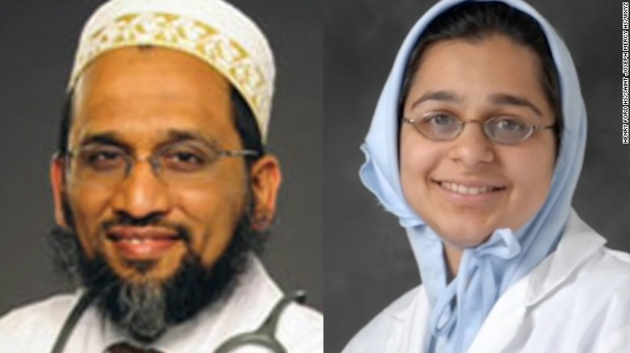
Dr. Jumana Nagarwala –
1st Physician Arrested in the U.S.
Dr. Jumana Nagarwala, 44, U. S. citizen; medical school at Johns Hopkins; ER physician in Detroit;
Member of the Dawoodi Bohra religion (origins in Yemen, but spread to India, Sri Lanka, Pakistan);
1st physician arrested in U. S. after Federal complaint filed April 12, 2017;
100 girls cut over past 10 years
In prison until Sept 29—released on $4.5 million unsecured bond
Trial anticipated mid to late 2018

Slide 29
Dr. Fakhruddin Attar
Dr. Fakhruddin Attar, 53, and his wife Farida Attar, 50, are accused of Conspiracy to Commit Female Genital Mutilation and Aiding and Abetting Female Genital Mutilation;
2nd physician arrested April 21, 2017;
Procedures were performed in his office;
Wife helped restrain during procedure.

Slide 30
State Law—24 states as of March 2016 (no updates)
Child Protection Laws apply in each state
Minnesota— 144.3872, 609.2245 passed in 1994; Effective 8/1/95
  Cultural/ritual reasons, and/or consent is not a defense;
  law provides for community education & outreach
  Sentence is imprisonment up to life &/or fine
Pennsylvania—no specific law applicable

Slide 31

Contact Us

